Slide 1
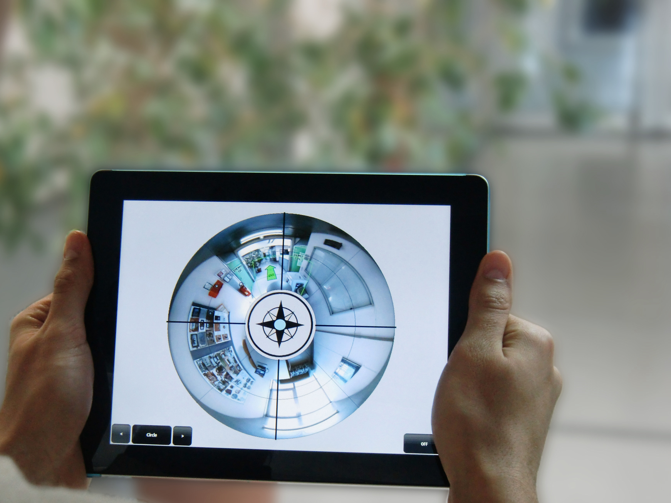
360° Panoramic Overviews for Location-Based Services Alessandro Mulloni Hartmut Seichter, Andreas Dünser, Patrick Baudisch, Dieter Schmalstieg
Notes:
patrick:
- Get in directly with video teaser from madness
Try to involve the audience from the start (maybe add panorama from the room?)
spend a little more time on the design of the techniques
More briefly through results, stress qualitative part
Overall, avoid the paper “compare this against blabla”

Slide 2
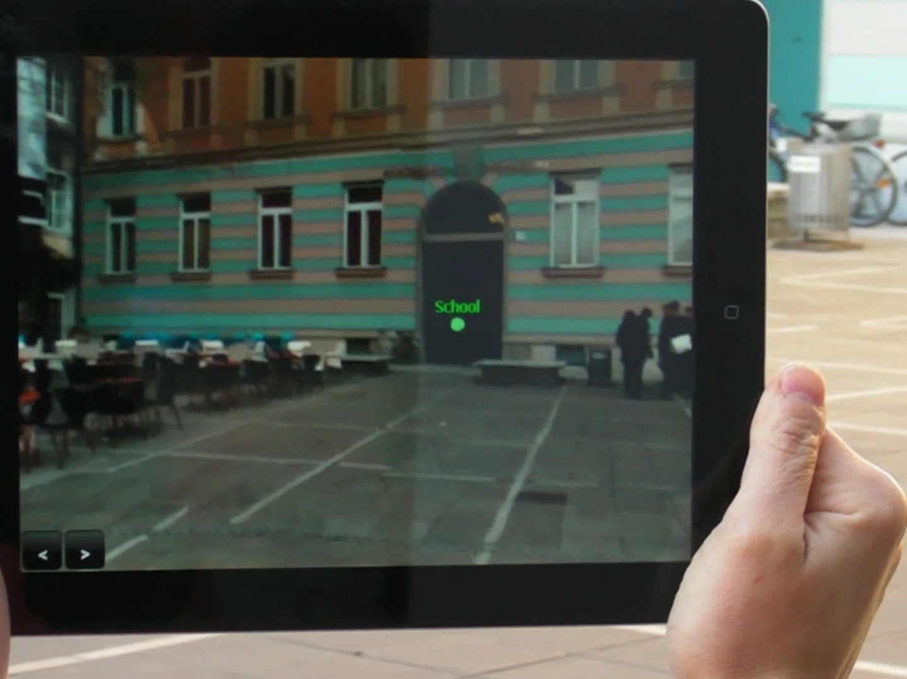
lack of overview

Slide 3
Notes:
** INTRODUCE IDEA

Slide 4
360° panorama = overview
Notes:
Still first-person imagery

Slide 5
360° panorama = overview
(first-person)
⩗
Notes:
Still first-person imagery

Slide 6
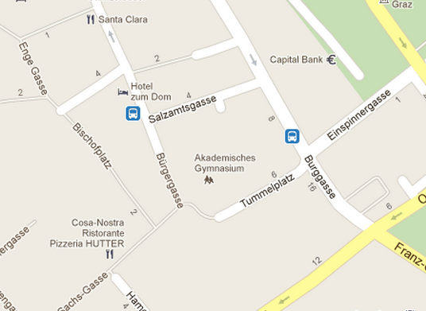
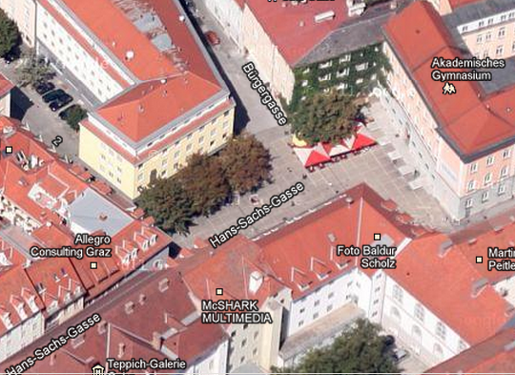
360° panorama = overview
(first-person)
⩗
Notes:
Still first-person imagery

Slide 7
related work
Notes:
** RELATED WORK: panoramas as rectangles

Slide 8
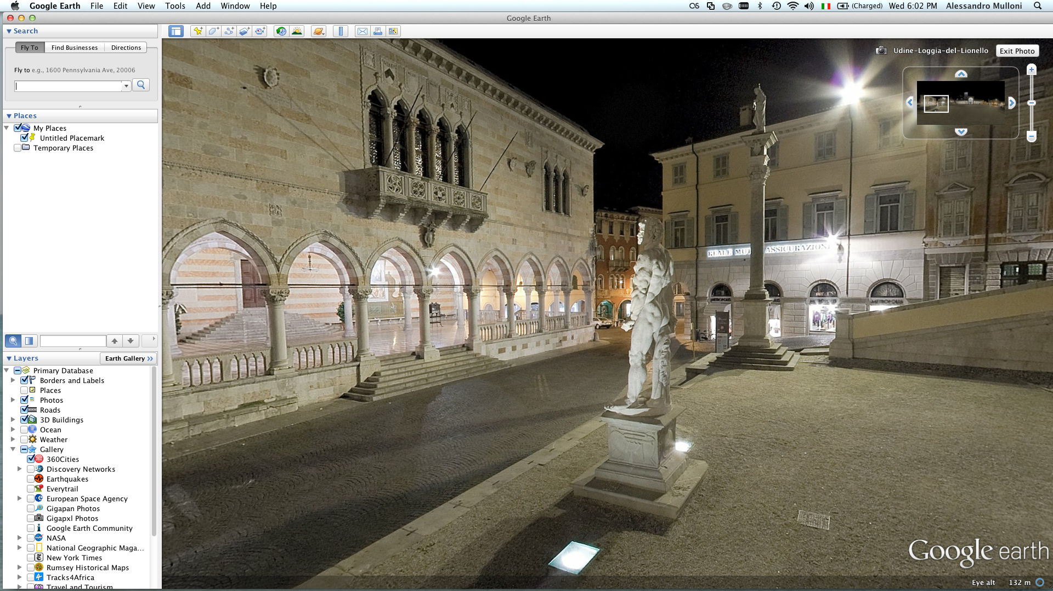
related work
[Google Earth]

Slide 9
related work
[Google Earth]

Slide 10
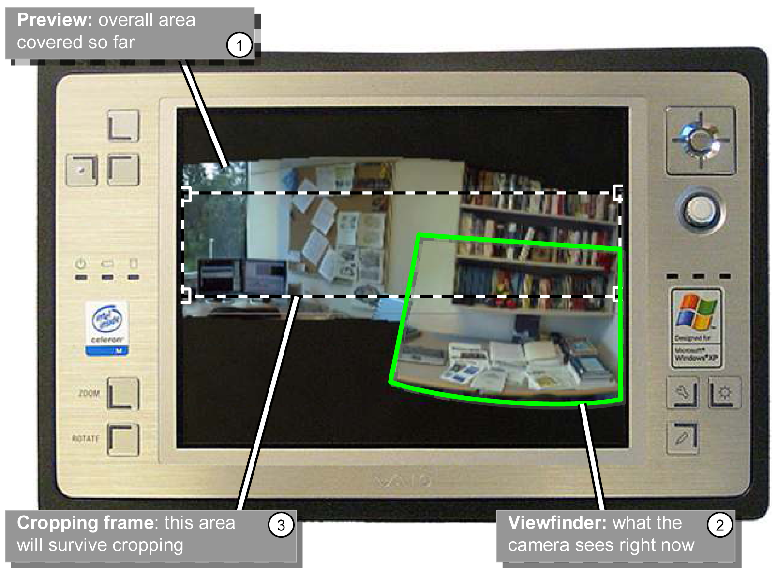
related work
[Baudisch 2005]

Slide 11
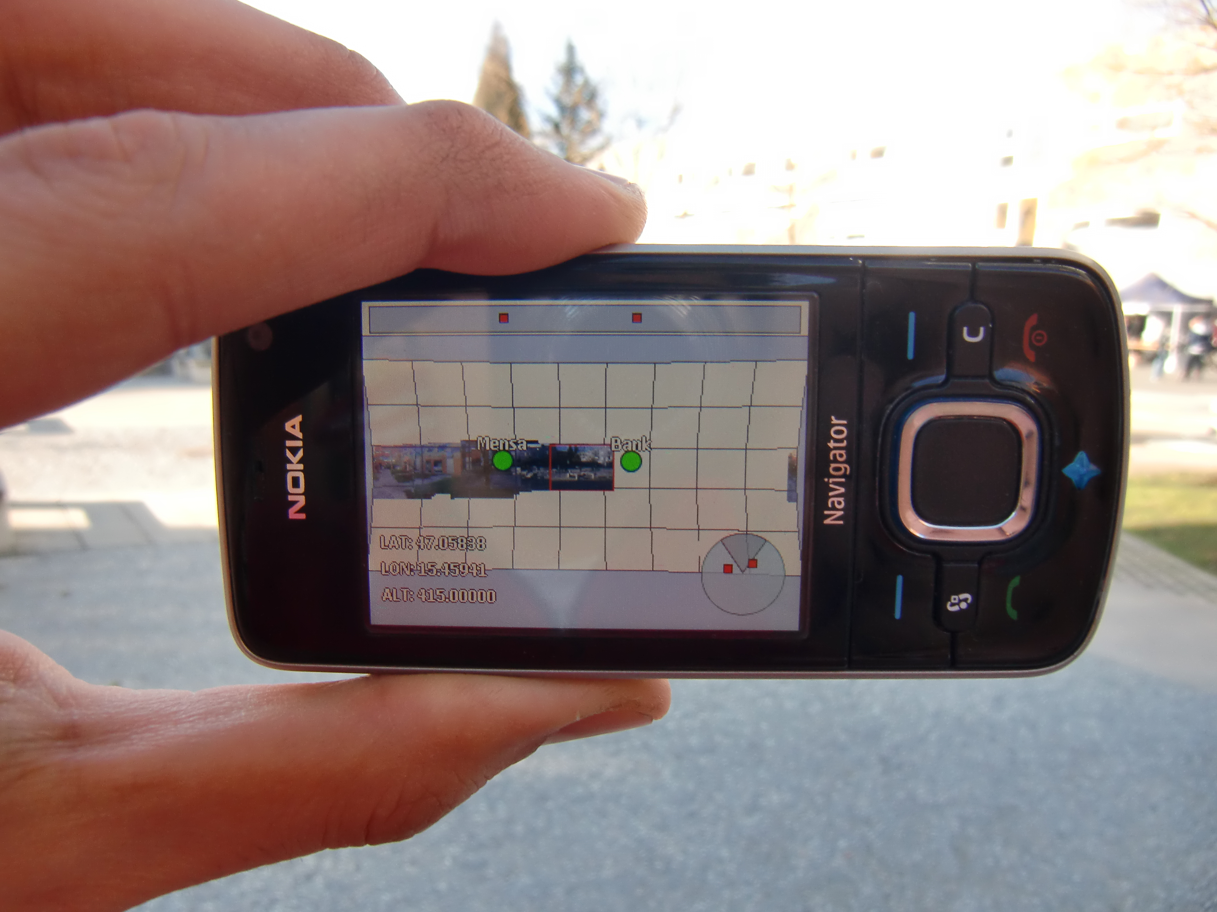
related work
[Mulloni 2010]

Slide 12
problem

Slide 13
problem
left/right in the visualization are
actually behind the user

Slide 14
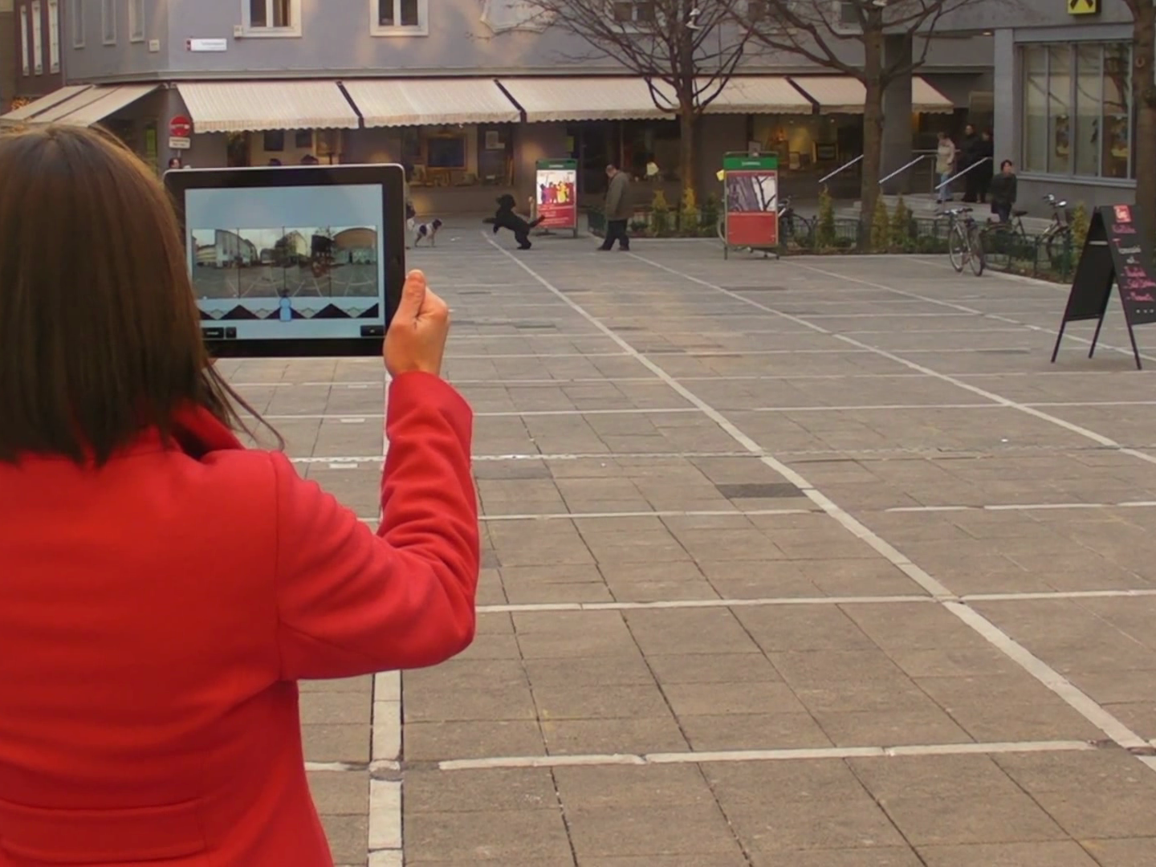
users are co-located with the panorama
Notes:
users are IMMERSED in the environment

Slide 15
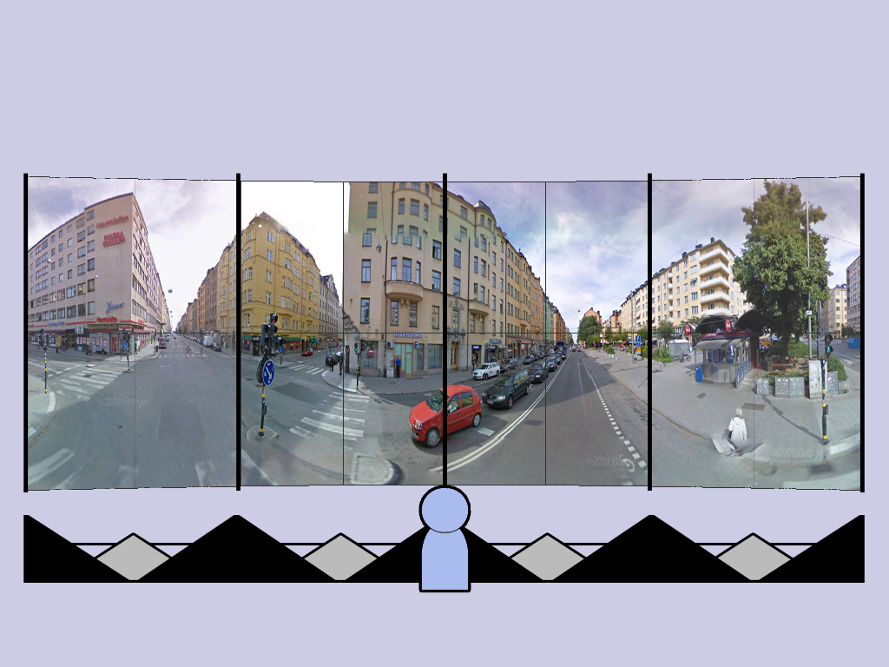

Slide 16
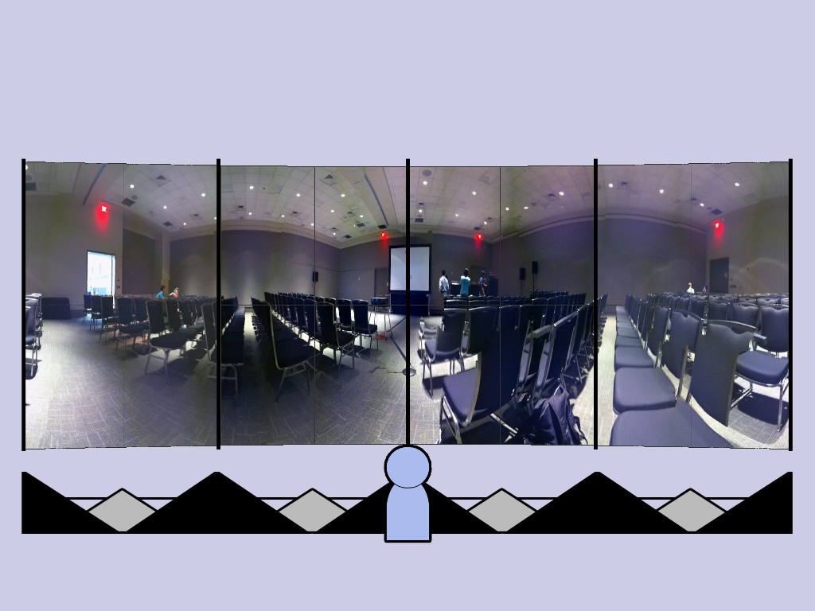

Slide 18
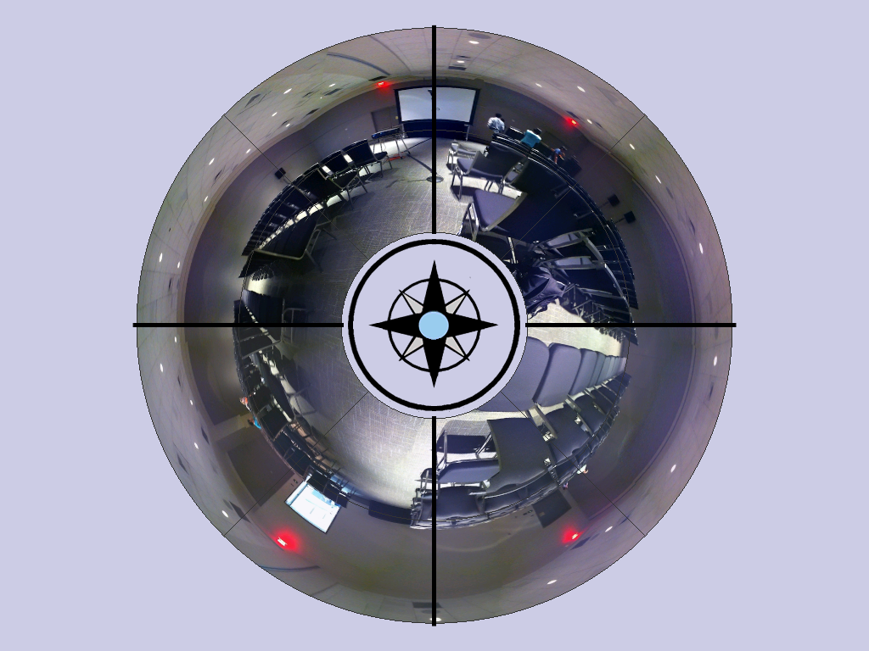

Slide 20
interface design
panoramic image
Notes:
** DESIGN: image AND shape

Slide 21
interface design
panoramic image
+
its spatial orientation
Notes:
Different compromises

Slide 22
frontal

Slide 23
bird’s eye

Slide 24
top-down

Slide 25
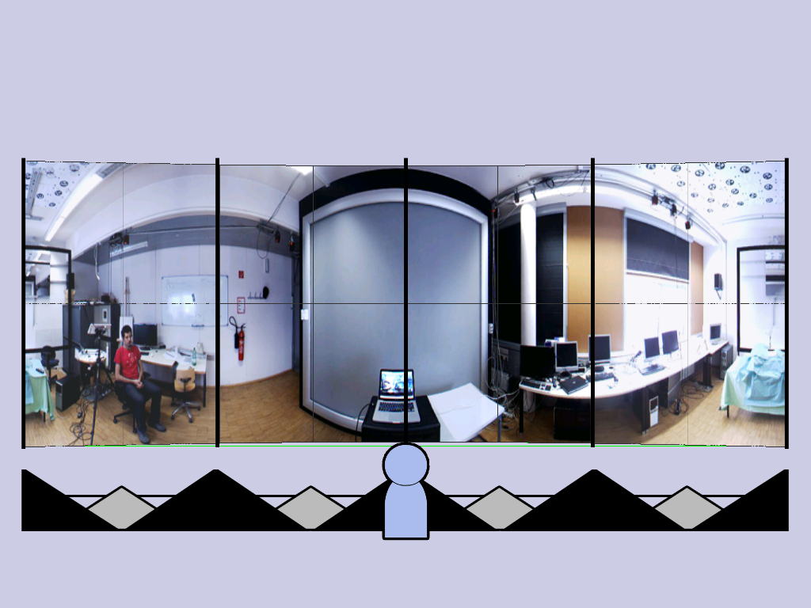
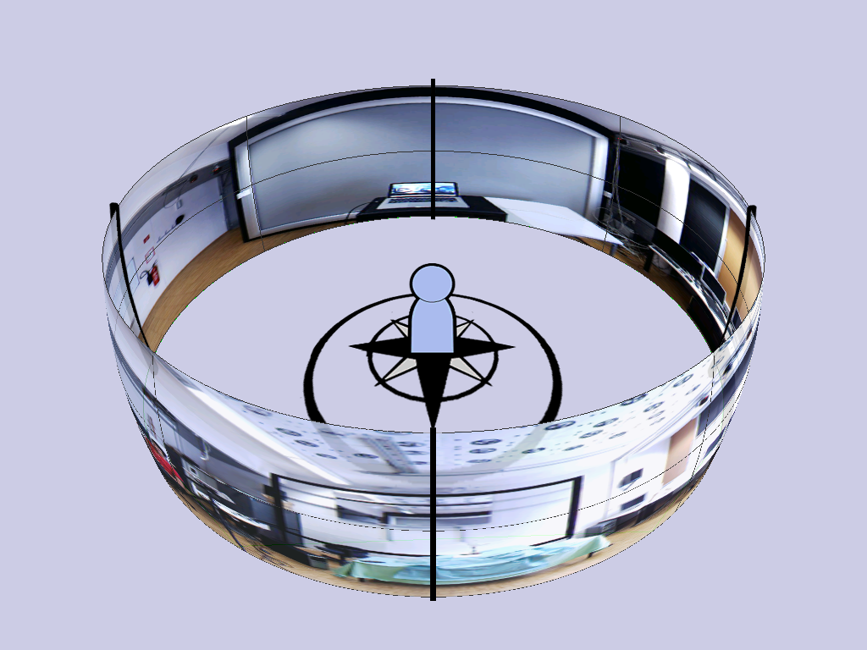
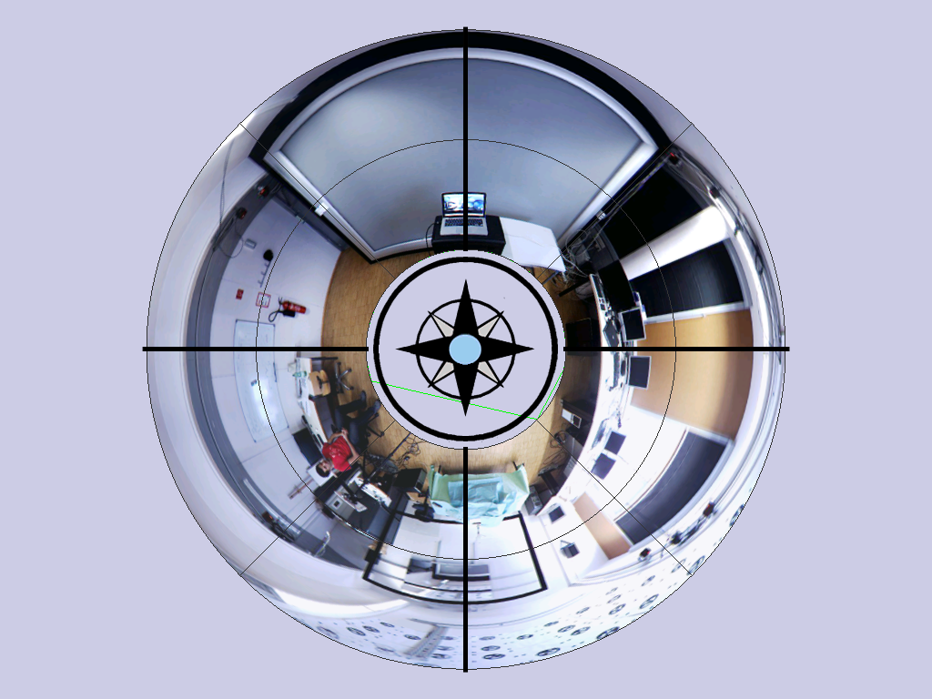
research question
how do people use these overviews to locate points in the environment?
Notes:
** QUESTION

Slide 26
experimental setup
pointing task (as accurate as possible)

Slide 27
experimental setup
pointing task (as accurate as possible)

Slide 28
experimental setup
pointing task (as accurate as possible)

Slide 29
experimental setup
pointing task (as accurate as possible)

Slide 30
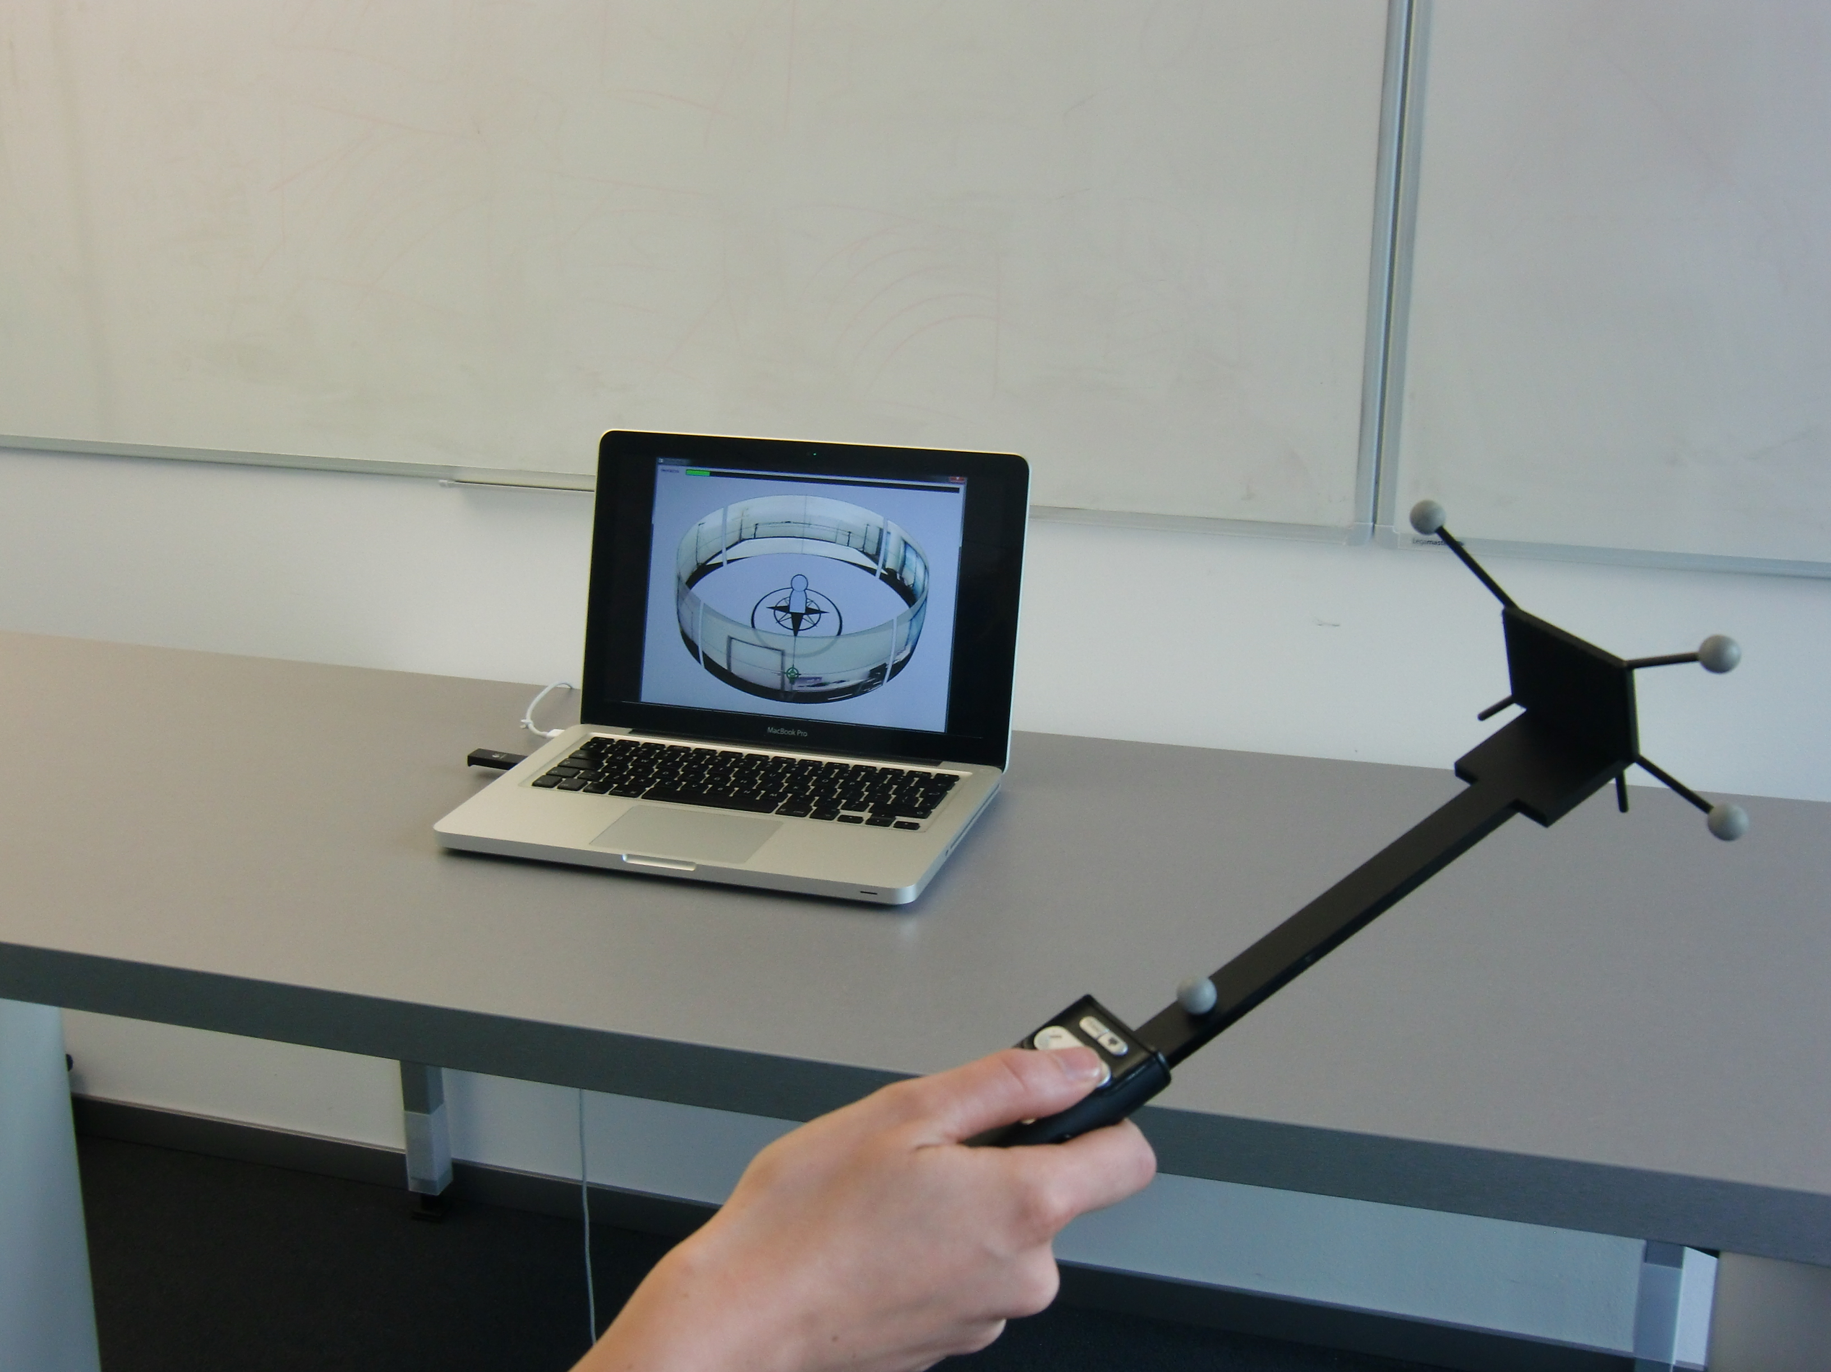
controlled setup

Slide 31
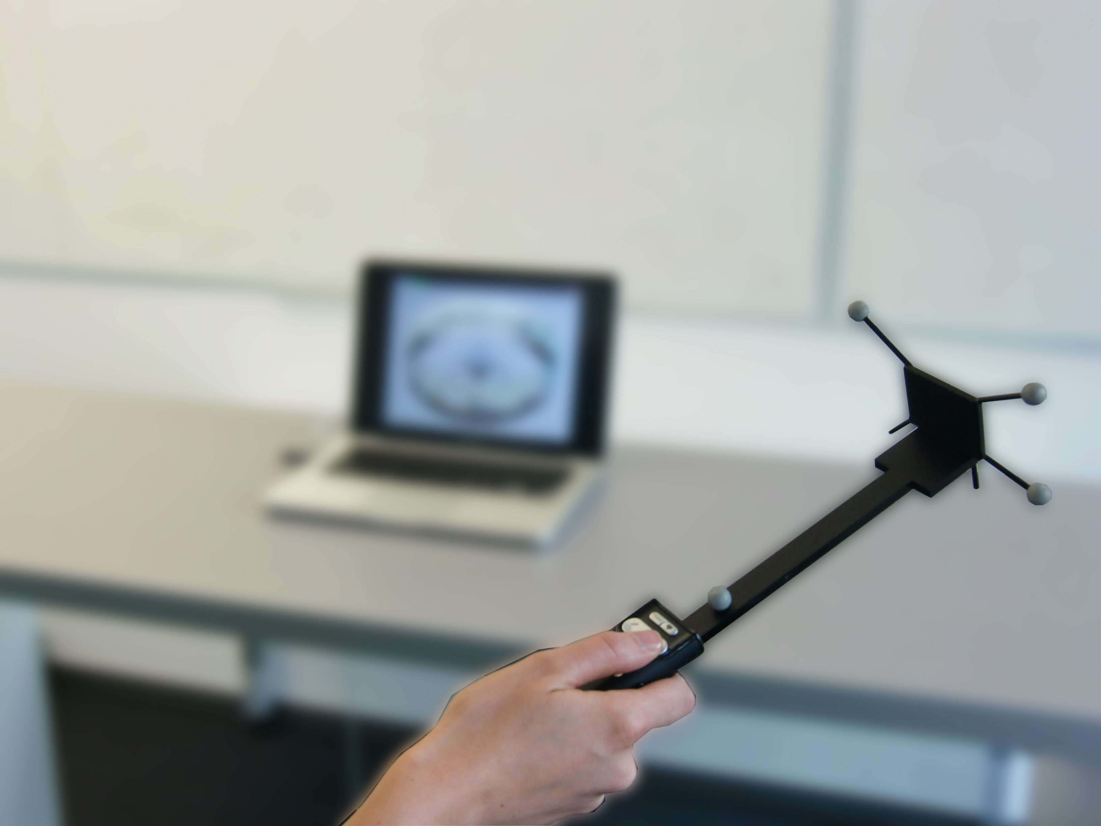
accurately measure timing and motion data

Slide 32
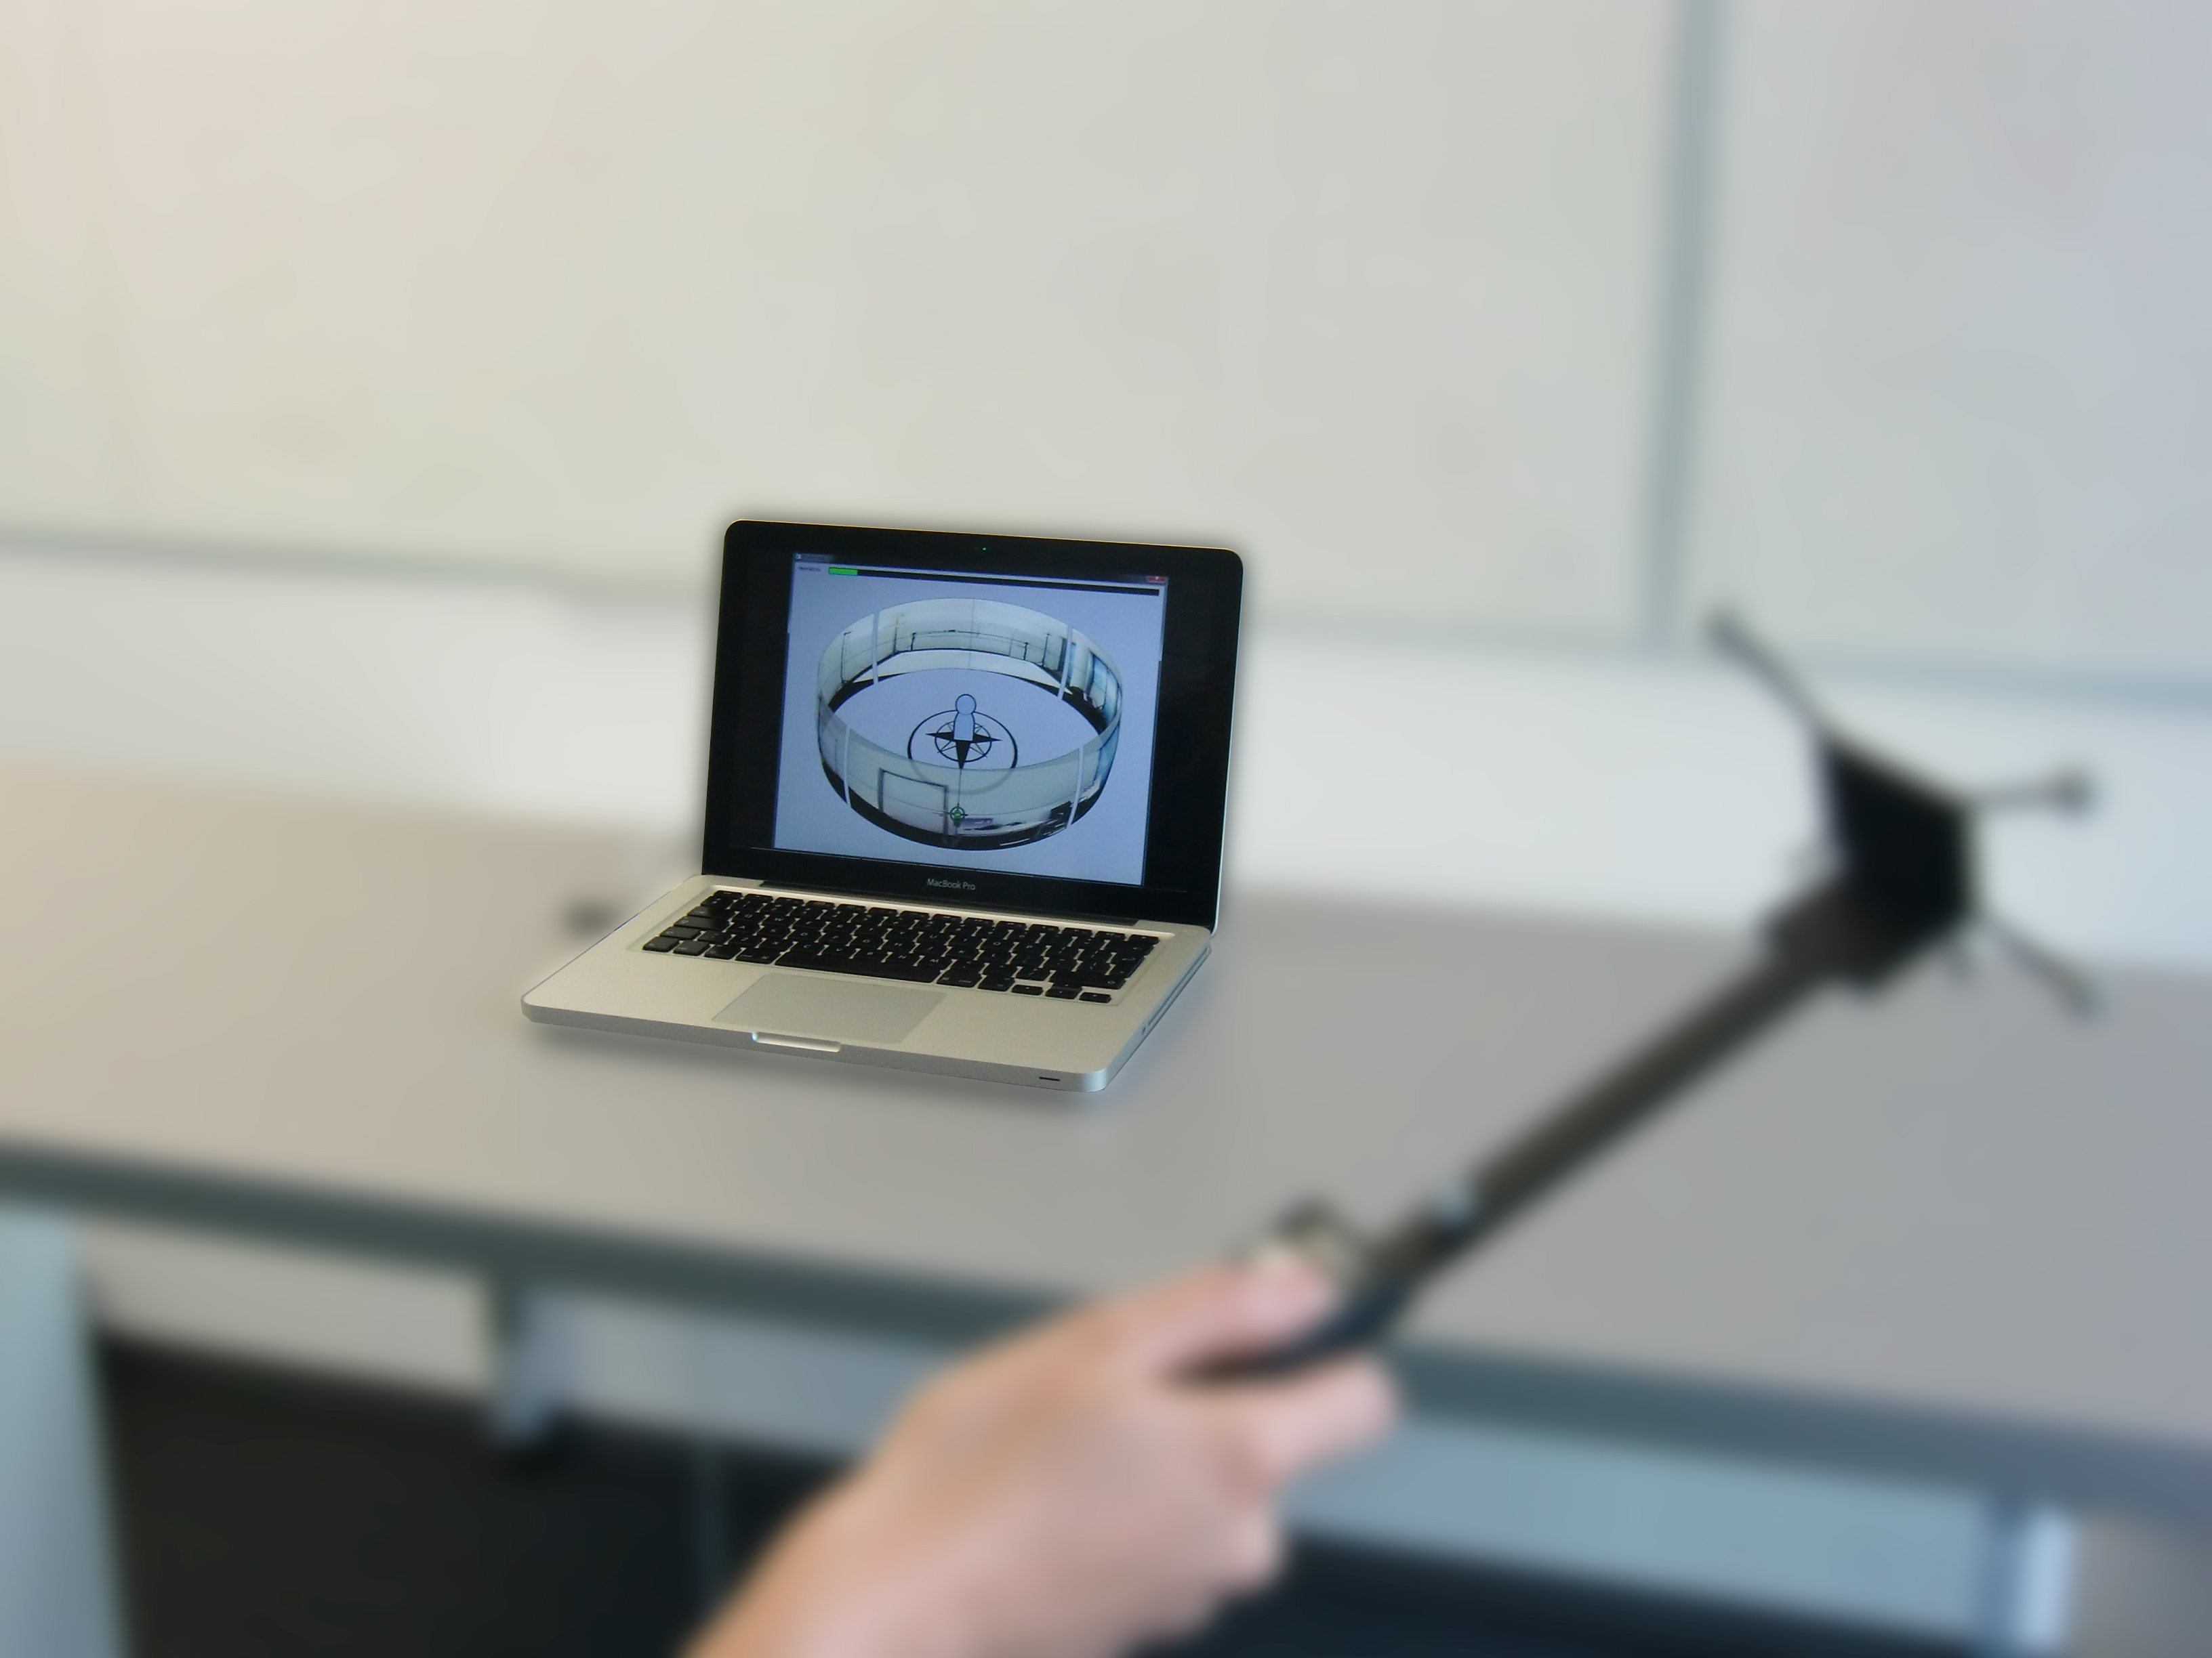
no effect of interaction with the device

Slide 33
research question
how do people use these overviews to locate points in the environment?
Notes:
** QUESTION

Slide 34
pilot study
pilot (4 participants)
Notes:
** FIRST ANSWER

Slide 35
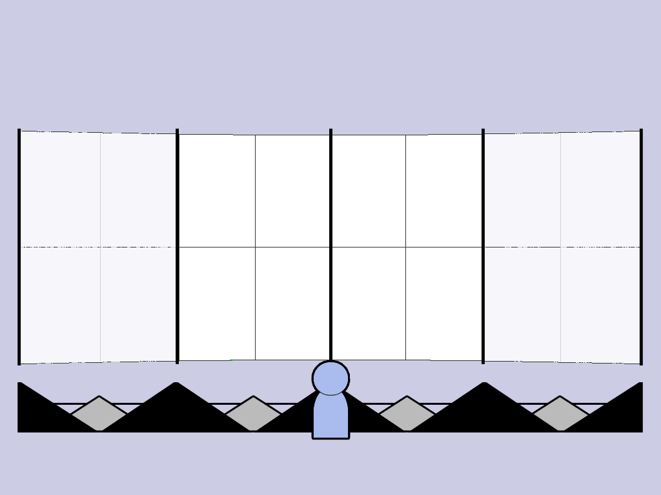
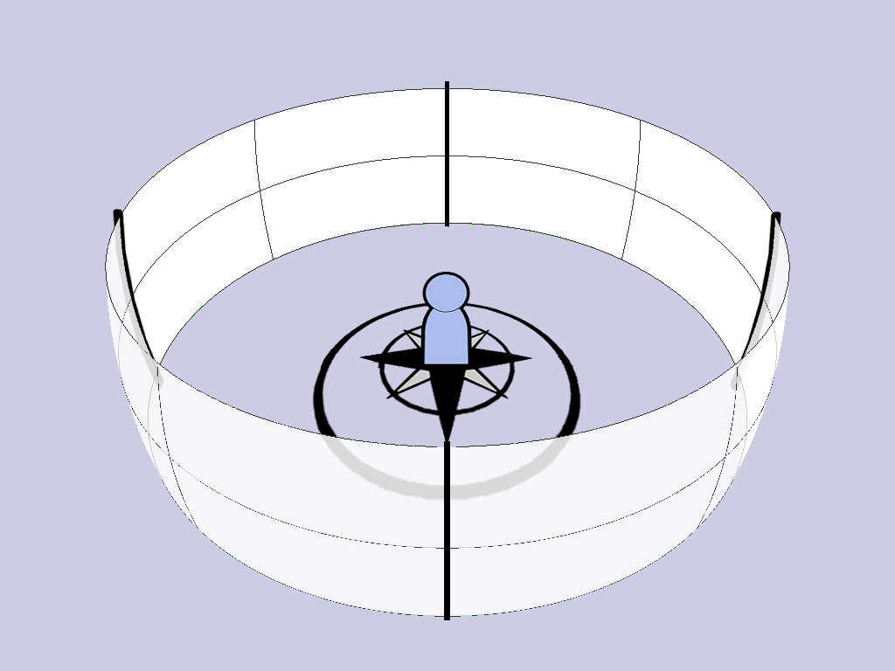
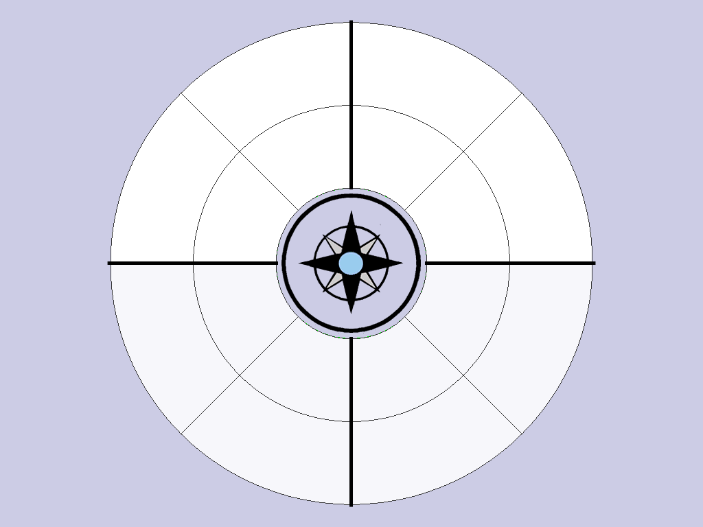
pilot study
pilot (4 participants)
1. find body-aligned directions
Notes:
** FIRST ANSWER

Slide 36
pilot study
pilot (4 participants)
1. find body-aligned directions
2. visual matching of objects
Notes:
** FIRST ANSWER

Slide 37
pilot study
pilot (4 participants)
1. find body-aligned directions
2. visual matching of objects
isolate the effect of the two strategies
Notes:
** FIRST ANSWER

Slide 38
user study 1
user study 1 (12 participants)
no support for visual matching
Notes:
** FIRST ANSWER

Slide 39
user study 1
user study 1 (12 participants)
no support for visual matching
Notes:
** FIRST ANSWER

Slide 40
user study 1
user study 1 (12 participants)
no support for visual matching
Notes:
** FIRST ANSWER

Slide 41
results
“I imagined myself
in the middle
of the visualization”

Slide 42
results
“I imagined myself
in the middle
of the visualization”
more “thinking”
was required

Slide 43
results
timings (with comparable accuracy)
frontal
top-down
bird’s eye

Slide 44
user study 2-3
user study 2-3 (12+12 participants)
same design as study 1
Notes:
** FIRST ANSWER

Slide 45
user study 2-3
user study 2-3 (12+12 participants)
same design as study 1
support for visual matching
Notes:
** FIRST ANSWER

Slide 46
user study 2-3
user study 2-3 (12+12 participants)
same design as study 1
support for visual matching
Notes:
** FIRST ANSWER

Slide 47
user study 2-3
user study 2-3 (12+12 participants)
same design as study 1
support for visual matching
Notes:
Pitch angle = 0

Slide 48
results
participants mainly resort to visual matching
independently of the shape

Slide 49
results
participants mainly resort to visual matching
independently of the shape
bird’s eye inconvenient, as the
sides are not visible or warped

Slide 50
results
timings (with comparable accuracy)
study 1
study 2
study 3
frontal
top-down
bird’s eye
top-down
bird’s eye
top-down
bird’s eye
frontal
frontal

Slide 51
summary
no panorama
study 1
perfect panorama
study 2 – 3
Notes:
Controlled user studies

Slide 52
summary
body-aligned directions
no panorama
study 1
perfect panorama
study 2 – 3
Notes:
Controlled user studies

Slide 53
summary
body-aligned directions
no panorama
study 1
perfect panorama
study 2 – 3
visual matching
Notes:
Controlled user studies

Slide 54
summary
body-aligned directions
no panorama
study 1
perfect panorama
study 2 – 3
visual matching
Notes:
Controlled user studies

Slide 55
summary
body-aligned directions
no panorama
study 1
real-world scenarios
perfect panorama
study 2 – 3
visual matching
Notes:
FALLBACK

Slide 56
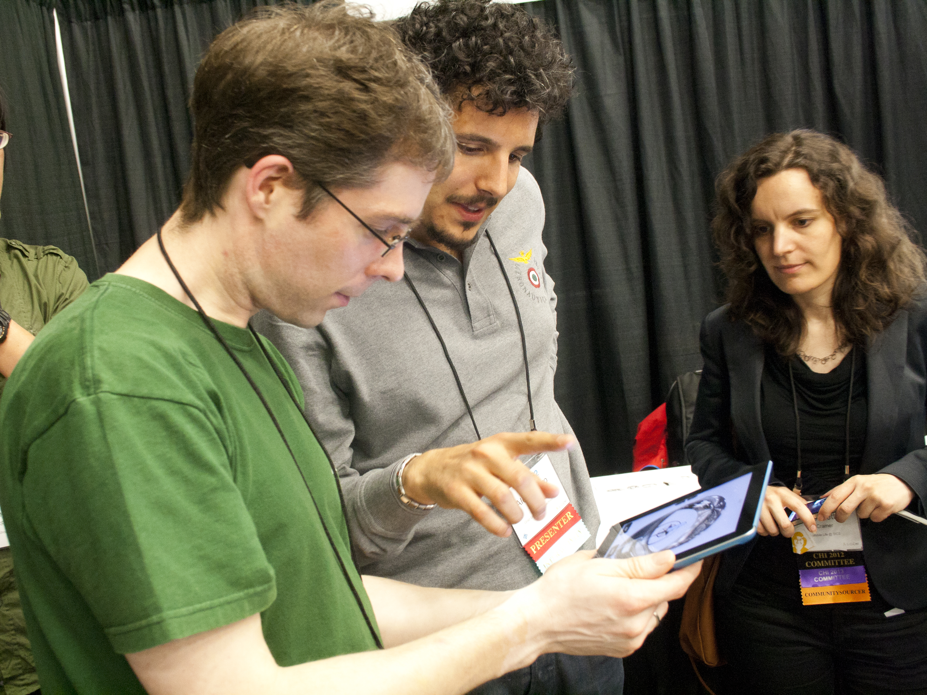

Slide 57
360° Panoramic Overviews for Location-Based Services Alessandro Mulloni, Hartmut Seichter, Andreas Dünser, Patrick Baudisch, Dieter Schmalstieg
body-aligned directions
no panorama
study 1
real-world scenarios
perfect panorama
study 2 – 3
visual matching
This research was supported by the Christian Doppler Lab for handheld Augmented Reality and Qualcomm
Notes:
FALLBACK

Slide 59
user study 1-2-3
180 = 3 (shape) × 12 (angle) × 5 repetitions

Slide 60
user study 1
180 = 3 (shape) × 12 (angle) × 5 repetitions
shape

Slide 61
user study 1
180 = 3 (shape) × 12 (angle) × 5 repetitions
shape
angle
(heading)

Slide 62
user study 1
180 = 3 (shape) × 12 (angle) × 5 repetitions
shape
angle
(heading)

Slide 63
user study 1
180 = 3 (shape) × 12 (angle) × 5 repetitions
shape
angle
(heading)
Notes:
PITCH angle was fixed to zero degrees

Slide 64
results
timings (with comparable accuracy)
top-down
bird’s eye
top-down
bird’s eye
top-down
bird’s eye
frontal
frontal
frontal

Slide 65
user study 1
timings (with comparable accuracy)
frontal
top-down
bird’s eye

Slide 66
user study 2-3
frontal
study 2
top-down
bird’s eye
frontal
study 3
top-down
bird’s eye

