Slide 1
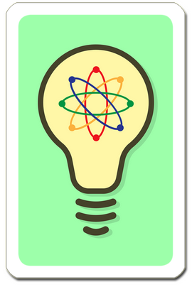
1
2
3
4
I. Think up combination ideas. Share afterwards.
3 Min.
3 Min.
3 Min.
3 Min.
3 Min.
1 & 2
1 & 2 & 3
1 & 3
1 & 2 & 4
1 & 4
3 Min.
3 Min.
3 Min.
3 Min.
3 Min.
2 & 3
1 & 3 & 4
2 & 4
2 & 3 & 4
3 & 4

Slide 2
1
2
3
4
II. Team up! What missing ideas can you think up collaboratively?
3 Min.
3 Min.
3 Min.
3 Min.
3 Min.
1 & 2
1 & 2 & 3
1 & 3
1 & 2 & 4
1 & 4
3 Min.
3 Min.
3 Min.
3 Min.
3 Min.
2 & 3
1 & 3 & 4
2 & 4
2 & 3 & 4
3 & 4

Slide 3
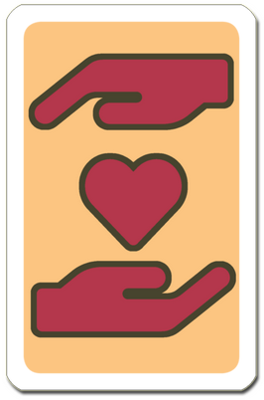
III. Refine your ideas to better address one or more values. Share afterwards.
3 Min.
3 Min.
3 Min.
3 Min.
3 Min.
1 & 2
1 & 2 & 3
1 & 3
1 & 2 & 4
1 & 4
3 Min.
3 Min.
3 Min.
3 Min.
3 Min.
2 & 3
1 & 3 & 4
2 & 4
2 & 3 & 4
3 & 4

Slide 4
Can you identify a principle that underlies one of your inventions?
Re-use the principle to invent something new. Share afterwards.
3 Min.
Principle underlying invention of
Principle underlying invention of
your earlier idea
your earlier idea
New invention based on the principle
New invention based on the principle
3 Min.
.
Principle underlying invention of
Principle underlying invention of
your earlier idea
your earlier idea
New invention based on the principle
New invention based on the principle
.
3 Min.
Principle underlying invention of
Principle underlying invention of
your earlier idea
your earlier idea
New invention based on the principle
New invention based on the principle

Slide 5
V. Select one invention you like best.
How might it be most easy and convenient for people to use your invention?
Invent a lot of other solutions to help your original idea work out.
Share afterwards.
my own invention
I like best
3 Min.
A lot of wild ideas how to facilitate the use of my invention

Slide 6
Team Workbench
Select one invention from each player for your community culture.
Fill the whole workbench with the most promising ideas that have emerged during the game.

