Slide 1
Code Visualization / TILIT
David Eickhoff & Stefan George Object-oriented Enterprise Application Programming Model for In-Memory Databases

Slide 2
Need & Motivation
Developers dive into code
Managers want to see status of project
Support needs to identify bugs and problems
Partners want to extend / customize parts

Slide 3
Existing Methods
Profiling
Static Code Analysis
Benchmarking
Tests
Reporting
Documentation

Slide 4
Interview with Balaji Vummiti
6 years ByD development
Release definition
Maintenance management
Testing
Quality management

Slide 5
Development process ByD
Scrum
Demo sessions at end of sprint
CPO > Area PO > PO > Developer Team
CPO reports to release Management
Testing
Vlab validation

Slide 6
Experience & issues
Always ask an experts
Mix front- & backend teams
Developers want freedom
No simple mapping between UI/Backend/BO
No documentation at coding level
Code standards are there but not used
PO doesn‘t see code

Slide 7
Existing Tools
Frontend inspector
SAT Tool
BO processing framework (bopf)
Automated tests (incl. UI Tests)

Slide 8
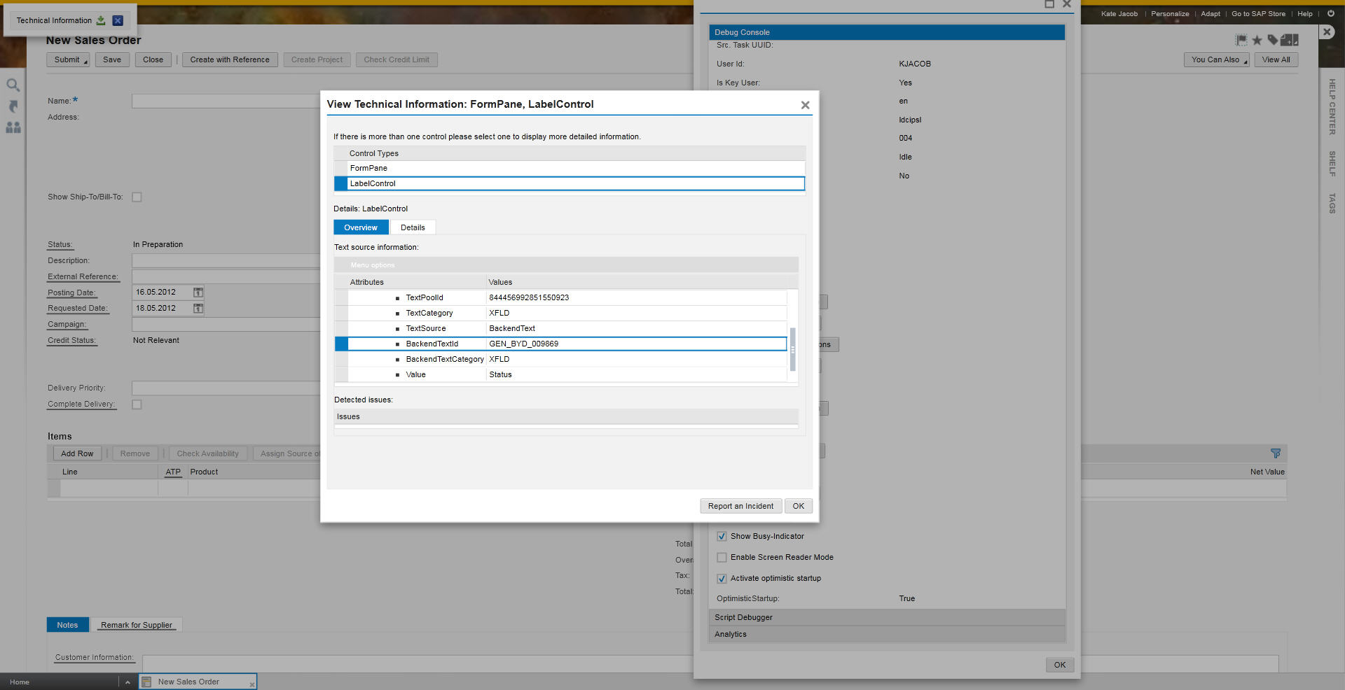
Frontend Inspector

Slide 9
BO processing framework

Slide 10
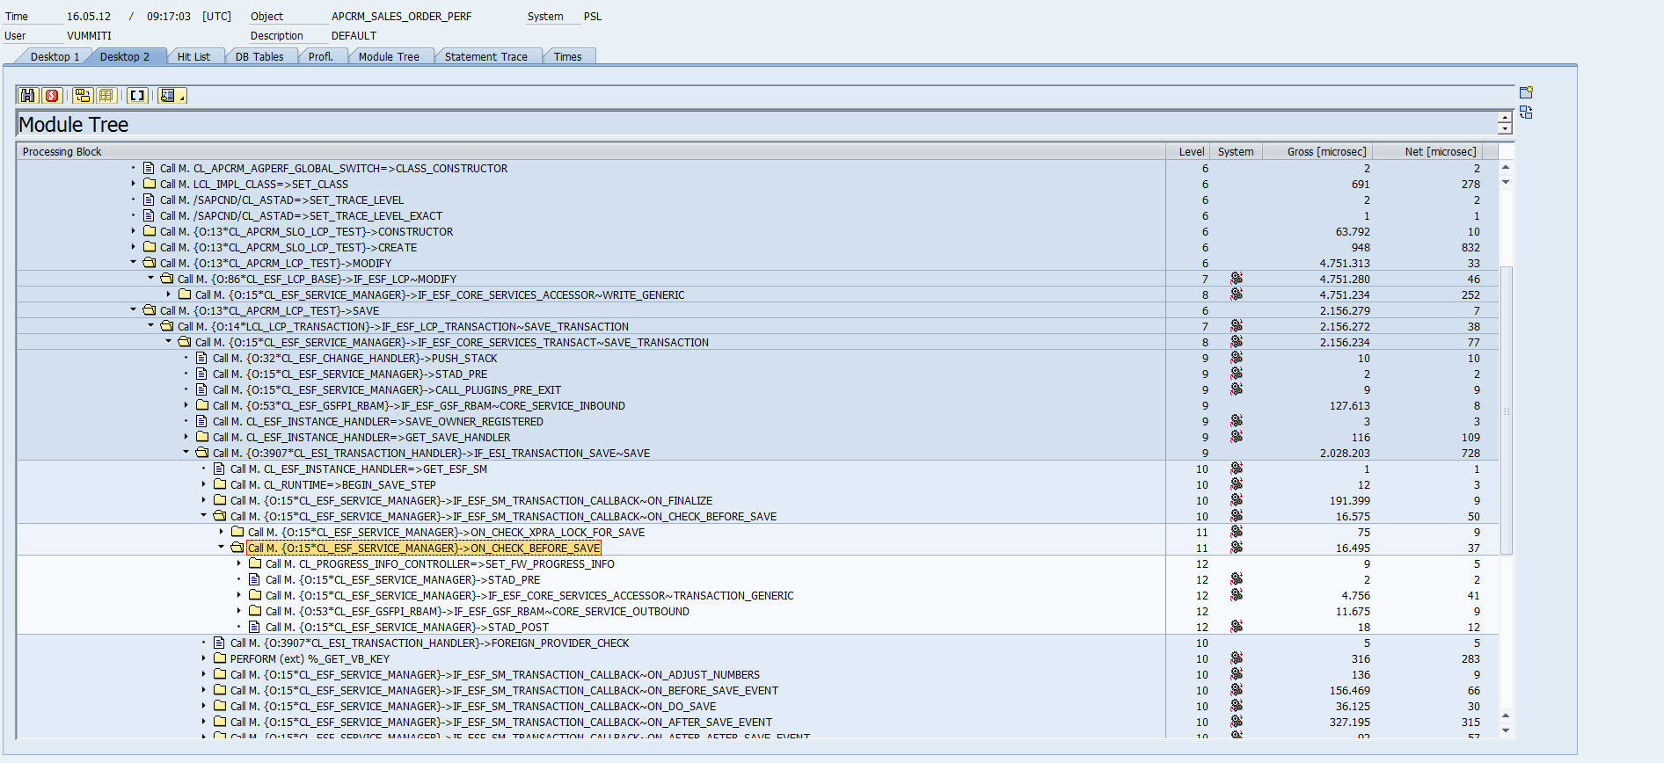
SAT Tool

Slide 11
SAT Tool
16mb compressed data (1 sales order)
3mio lines in most detailed view
connected to source code
compare different traces
Filter tree based on categories

Slide 12
Tests

Slide 13
Conclusion
There is a tool for every purpose
Not everybody knows how to use it
Applications don't offer an API
Access apps on database layer

Slide 14
Next Steps
Create visualization mockups
Different degree of information
Test concepts on Open Source ERP
Test New Relic with Open Source ERP

