Slide 1
Seminar: Enterprise Application Programming Model
Martin Lorenz

Slide 2
Organisatorisches
Rahmenbedingungen
Verantwortlich: Prof. Hasso Plattner
Tutoren: Martin Lorenz, Franziska Häger, Arian Treffer, Stephan Müller
Ort: SNB-E 9/10, Hasso Plattner High-Tech Park
Zeit: Dienstag, 11h00-12h30
4 Semesterwochenstunden
6 benotete Leistungspunkte
Einschreibefrist 31. Oktober 2012

Slide 3
Organisatorisches
Ziele des Projektseminars
Gesamtüberblick über das Themengebiet erlangen und das eigene Projektthema einordnen können
eigenständiges Einarbeiten in eine Themenstellung
spezielles Wissen im Projektthema gewinnen
Projekterfahrung sammeln
Präsentationstechniken aneignen
Grundlagen des wissenschaftlichen Arbeitens erlernen

Slide 4
Organisatorisches
Inhalte des Projektseminars
Vorstellung des Themengebietes
Einführung in wissenschaftliches Arbeiten
Präsentationen der Projektgruppen zu projektrelevanten Themen
Leistungserfassung
Projektergebnisse & Ausarbeitung 60%
Zwischen- und Endpräsentation 20%
Wissenschaftliches Arbeiten und persönliches Engagement 20%
Besonderheit: Keine Präsenzveranstaltungen. Ca. 60min Treffen pro Woche mit Betreuer.

Slide 5
Organisatorisches
Auswahlprozess für die Seminarthemen
Für Projektseminarthemen bewerben
Prioritätenliste abgeben
Im Seminar oder per Mail an Martin
Inhalt: drei priorisierte Wünsche
Deadline: 22. Oktober 2012
Zuordnung von Projektteams zu Projektseminarthemen (23.10.2012)

Slide 6
Fragen zur Organisation?

Slide 7
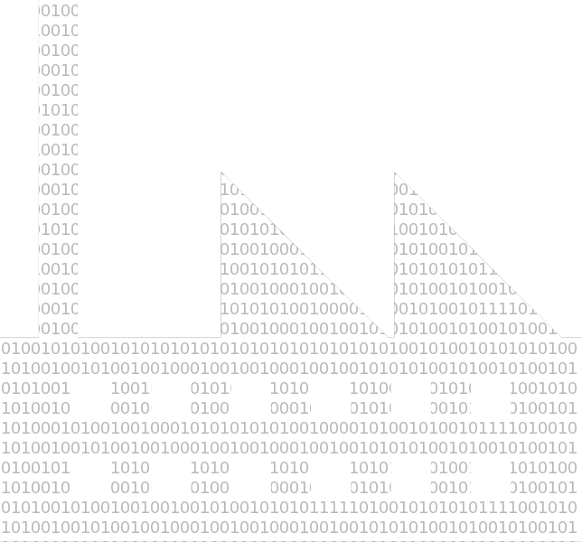
What is Enterprise Software?
“Enterprise applications are about the display, manipulation, and storage of large amounts of often complex data and the support and automation of business processes with that data.“
Martin Fowler „Patterns of Enterprise Application Architecture Patterns“ (2002)

Slide 8
The Essence
Large amounts of complex data derived from real world entities
Automation of business processes based on data
Business intelligence and decision support based on data

Slide 9
The essential Questions
How do we represent the data?
How do we interact with the data?
Class PurchaseOrderProcess {
...
public void releaseAllPurchaseOrders() {
List<PurchaseOrder> orders = getOpenP_Orders();
for(Order o : orders) {
o.setStatus(Order.RELEASED);
saveP_Order(order);
}
}
...
}
APP-Server
Database

Slide 10
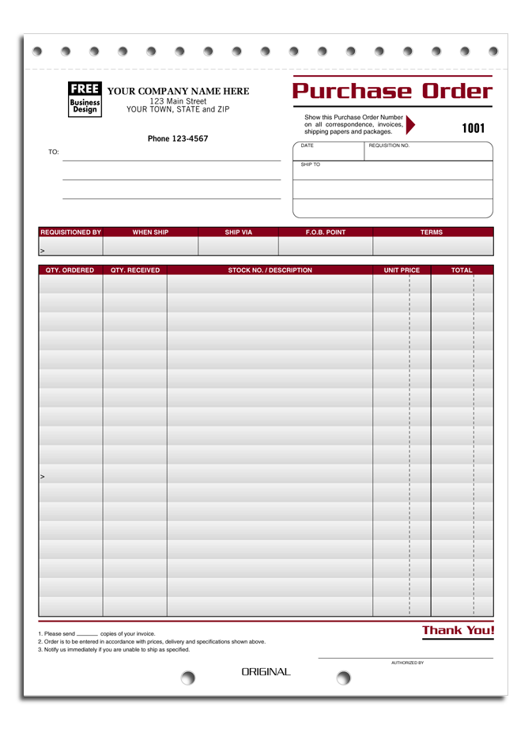
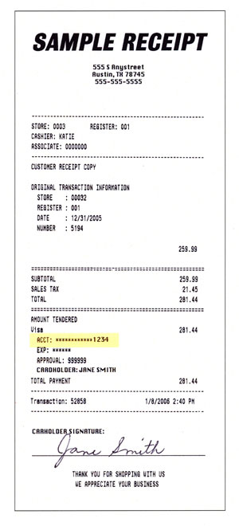
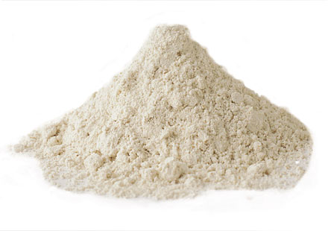
How do we represent the Data?
Order
Customer
Receipt
Product
Raw Material

Slide 11
Real World Entities
Attributes:
Date
Due Date
Customer
Line Items
Signature
etc.
Order

Slide 12
Programming Constructs
Example: domain model for oo programming environment
Line Item
Product
Amount
...
Receipt
1
1
Order
Date
...
Objects capture the relevant information of real world entities and give them a logical structure.
1
Date
Due Date
Status
...
1
*
1
Customer
Name
Address
...
*
*
Product
Raw Material
Name
Price
...
Name
Inventorylevel
...
*
*
Notes:
OO gut geeignet um komplexe Daten zu strukturieren.
Abstraktion z.B. von physikal. Eigenschaften
Anreicherung von Daten z.B. Status zur Umsetzung von Prozessen

Slide 13
Persistent Storage
Example: Relational Database Management Systems (RDBMS) normalization
receipt
order
lineitem
customer
address
product
id
date
fk_order_id
id
date
due_date
status
id
fk_product_id
fk_cutomer_id
amount
id
name
fk_address
id
city
zipcode
street
id
name
price
raw material
id
name
inventorylevel

Slide 14
The Mapping Problem
Real World
Programming Environment
Database
Notes:
Problem: Mapping nicht eindeutig!! Hängt immer von den umzusetzenden Geschäftsprozessen ab und der verwendeten Technologie ab.

Slide 15
How do we interact with the Data?
There are two interaction models
Online Transaction Processing (OLTP)
Entity management
Online Analytical Processing (OLAP)
Analytics
Single Record Processing vs. Set Operations

Slide 16
Challenges for Enterprise Software
Massive code base
Handle a lot of data
Access data concurrently
Conceptual dissonances within data
Customer structure for dept. 1 <> customer structure for dept. 2
Complex business “illogic”
Data schema evolution triggered from
inside (e.g., change DB)
outside (entity evolution, new business functions)

Slide 17
Fragen zum Inhalt?

Slide 18
Seminar Topics
SQL Pattern Search
SQL4JAVA
Object Inheritence in RDBMS
Visualization of Execution Traces
Immediate Feedback for Programmers
Application Characteristics
Materialized Aggregates Maintenance

Slide 19
SQL Pattern Search
SOURCE CODE:
LOOP AT TOTAL.
...
SELECT SINGLE FOR UPDATE * FROM <table> WHERE ...
...
ENDLOOP.
SQL:
SELECT *
FROM AST as AST1, AST as AST2, INCLUDE, SOURCE
WHERE AST1.vertex_value = ‘SELECT_STMT‘
AND AST2.vertex_value = ‘LOOP_COMP‘
AND AST1.origin = AST2.origin
AND AST1.pre_order <= AST2.pre_order
AND AST1.post_order >= AST2.post_order
AND INCLUDE.hash = AST1.hash
AND SOURCE.origin = INC.hash;

Slide 20
SQL4JAVA
public static Double calculateAmount() {
Double amount = 0;
Connection conn = PersistencyManager.getConnection();
try {
Statement stmt = conn.createStatement();
ResultSet result = stmt.executeQuery("SELECT SUM(amount) as amount FROM orders");
while(result.next()) {
amount = result.getDouble(“amount”);
}
stmt.close();
conn.close();
} catch(SQLException e) {
e.printStackTrace();
}
return amount;
}
public static Double calculateAmount() {
Double amount = SELECT SUM(amount) FROM orders;
return amount;
}

Slide 21
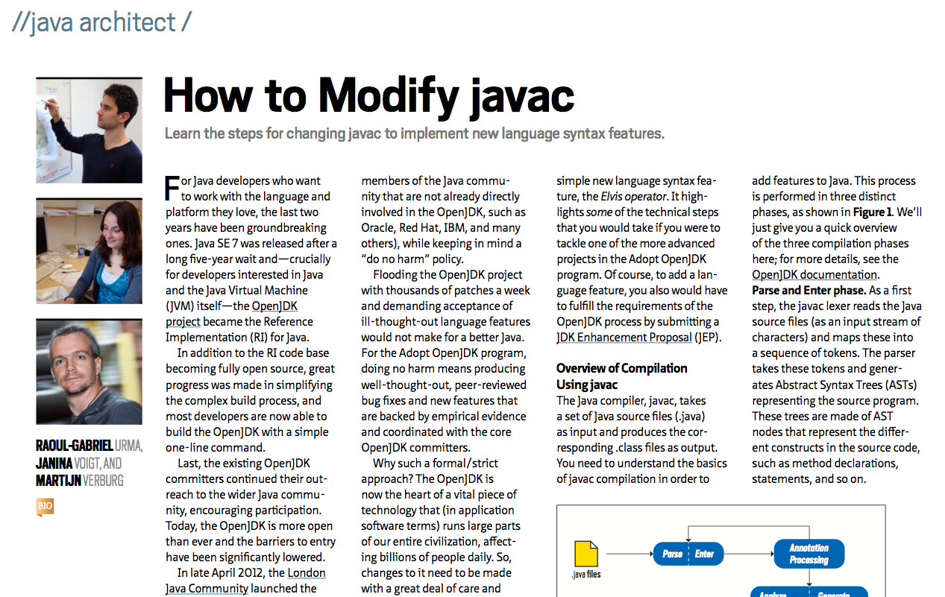
SQL4JAVA

Slide 22
Object Inheritance in an In-Memory Database
Vehicle
Car
Motorcycle
Bicycle
Programming Environment
Bus
Truck
SUV
Database
???
???
???

Slide 23
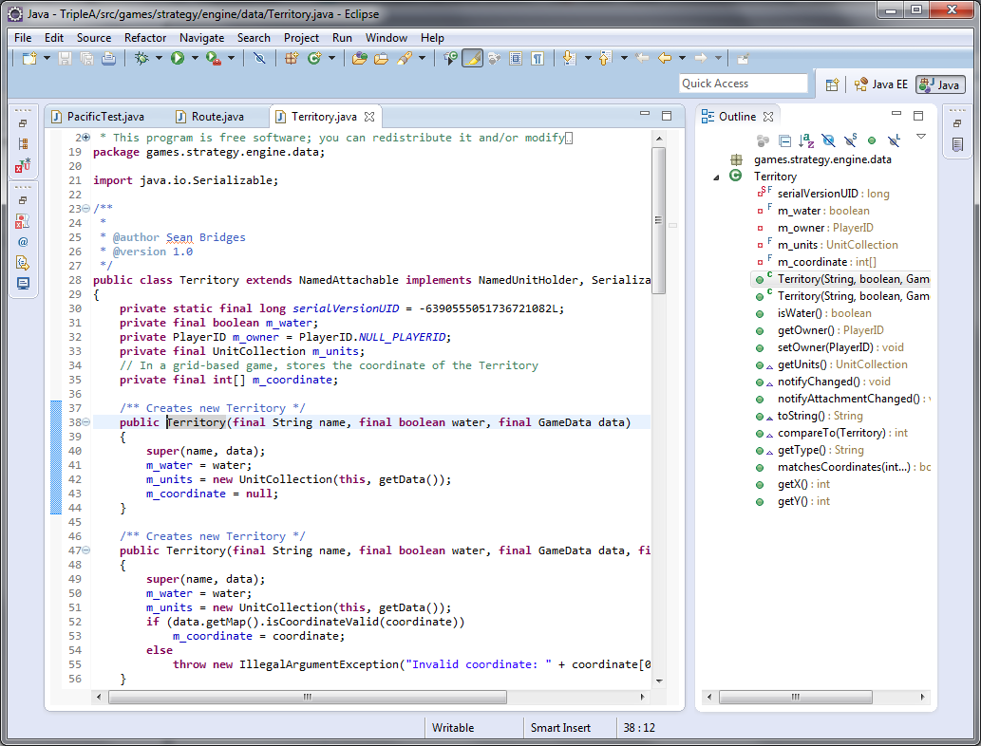
Visualization of Execution Trace Data
testCanMoveNavalBase (20 incovations)
+ name="Bonin" water=false data=GameData@1
+ name="4 Sea Zone" water=true data=GameData@1
+ …
testCanLandAirfield (20 incovations)
+ name="Bonin" water="false" data=GameData@1

Slide 24
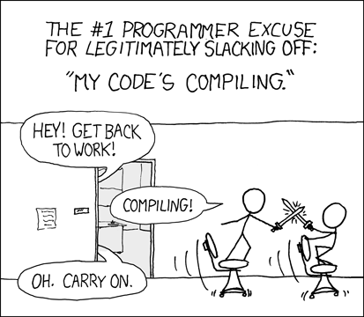
Immediate Feedback for Programmers Introduction
Do you know that?
What if you could see how your code changes the outcome immediatly?
Check out Bret Victors approach: http://vimeo.com/36579366
Notes:
Waiting for cpmpilation, build, tests, try and error can take a while
Papers on the topic:http://lampwww.epfl.ch/~mcdirmid/mcdirmid07live.pdf; citeseerx.ist.psu.edu/viewdoc/download?doi=10.1.1.34.8753&rep=rep1&type=pdf
Additional Video: http://vimeo.com/23839605

Slide 25
Immediate Feedback for Programmers Research Questions
How could enterprise application development benefit from immediate feedback?
Which programming tasks benefit most from immediate feedback (e.g. debugging, programming, testing)?
How can immediate feedback be implemented and integrated into common IDEs?

Slide 26
Application Characteristics
Motivation: Database should know how the application behaves to tune data model and materialization strategies for optimal performance
Research Questions:
How can app characteristics be extracted from an application workload (SQL traces, dictionary access)?
Evaluate different languages to describe app characteristics in a way consumable for a caching/materialization manager within the database

Slide 27
Materialized Aggregates Maintenance
Data updates need to be propagated to corresponding materialized aggregates (transparent for application)
Research Questions
Evaluate existing maintenance strategies within the context of an IMDB (Hyrise, HANA)
Focus on correlation with the Merge process
Discuss “garbage collection” strategies for aggregates

