Slide 1
Business ByDesign Attributes Analysis
Team: Ekaterina Gavrilova, Lars Butzmann

Slide 2
Business By Design...
> 1000 standard business object types
>10 nodes for every business object
Each maps to one or several database tables
Each maps to database table fields
> 100 attributes for every business object
Notes:
is a fully integrated on-demand Enterprise Resource Planning and business management software product designed for small and medium sized enterprises^{[1]}. It is delivered online as a Software as a Service offering.
ByD:
> 1000 standard business object types
>10 nodes for every business object, each of them is mapped to database tables
> 100 attributes for every business object, each of them is mapped to database table fields
That means really huge amount of data and complex data schema.
To analyze existing BO attributes used in ByD solution the research for the BO Sales order was performed by Juergen, Ralf together with SAP colleagues.
problem description:
70.000 table
300.000 columns

Slide 3
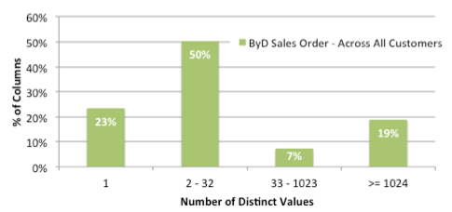
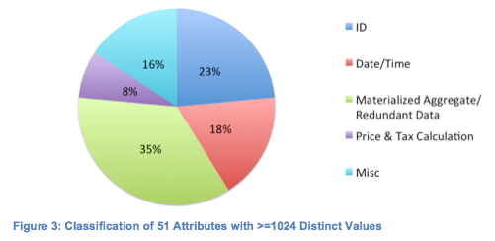
Sales Order Attribute Analysis
Notes:
Interesting results of the research is shown on this slide. On the first graphic we see the statistic for BO attributes for the BO Sales order: attribute usage across selected customers.
We can see here, that across all analyzed customers, 33% attributes of all attributes have number of distinct values =1, that means that they are never used and probably can be eliminated.
The second diagram shows categorization for fields with many distinct values (>1024 dv). The result of the categorization is quite interesting and surprising. 42% of these fields can be theoretically calculated on the fly (without storing them in database) – so called materialized aggregates.
Using these results, we’ve formulated the following questions (or direction) of the further investigation

Slide 4
Related Questions and Problems
Which of the BO attributes can be eliminated?
Which of the BO attributes can be calculated on the fly?
Can we suggest more optimal database schema
for business objects?
Notes:
Which of the BO attributes can be actually eliminated?
Basing on investigation of the selected 37 customers, 33% of attributes are not used in the BO ‘Sales order’. But to say for sure whether we can eliminate the attribute we have to be sure that this attribute (naming DB field) is not used by some other BO or by customers in the specific industry field. So, this needs additional investigation
2) Which of the identified materialized aggregates can be calculated on the fly with a real benefit to memory consumption and response time
3) Can the more optimal DB schema for ByD BO be suggested

Slide 5
Our Research Steps
To understand business object structure;
To select the subset of business objects with the common technical structure;
To understand mapping between attributes and database table fields;
To focus on the concrete business object (sales order) and materialized aggregate analysis.
Notes:
To investigate the problem, we follow the steps mentioned on this slide.
Here we used standard SAP ByD interface – MDRS, which provides access to the BO, description and structure, nodes and attributes and information system
Every BO in ByD is associated with the development framework. And the objects of the same framework have common technical background (data schema, tables, attribute-fields mapping). For our investigation, we’ve selected CRM objects which are developed on CDF-framework.
For the selected framework, we’ve investigated db schema and BO attributes’ –table fields mapping.
As a final decision – we will investigate sales order BO. Our main focus is calculation of materialized aggregates: to identify m.a. that can be calculated on the fly and to estimate the gain in memory consumption and response time.

Slide 6
ByD Business Objects Examples
Customer
Product
Sales order
Service order
Contract
Email activity
Fax activity
Notes:
Regarding the first two mentioned on the previous slide steps: there are some examples of the BO in ByD. We can notice, that they can relate to different types of data , different industry, etc
F.e. Customer, Product: master data; SO, Serv order, contract – docs; email, fax – activities

Slide 7
ByD Business Object Structure
Business Object
Nodes
Attributes
Example: Sales Order (some nodes and attributes)
Root
Buyer data;
Posting date;
Administrative information;
Item
Product name;
Quantity;
Delivery information;
Total values
Volume;
Price;
Tax;
Notes:
That’s how every BO looks like in general: it contains the number of nodes (correspond to DB tables level), each node contains the number of attributes (correspond to DB fields). Here is an example of some nodes and attributes of the business ob ‘sales order’ on which we’ll focus on as was mentioned above

Slide 8
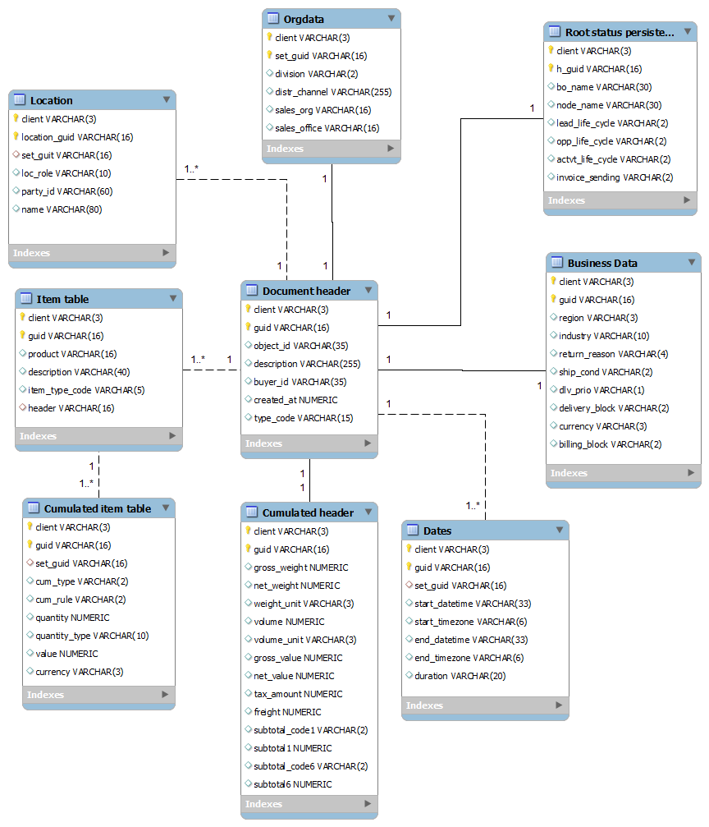
CDF-Framework: CDAD Tables
Notes:
We did the mapping of the attributes of CRM BO (CDF dev framework) to the fields of the database tables. For these objects CDAD- tables are used to store the data. These are such ob as sales order, contract, service order, etc. To store these ob the same DB tables are used. Each BO uses the set of fields in these tables. All attribute tables are connected to the central table that contains information related to the header and the central BO data like object_id, type_code, etc. These fields are used by all types of CDF objects. Other attribute tables can be used or not used dependently on the concrete BO type. The mapping helps to identify the tables fields that should be analyzed for BO of different types and can be used in case if the other types of CRM objects in CDF-framework will be investigated later.

Slide 9
Initial Information: Sales Order Fields Analysis
Notes:
Last Exchange with SAP
Focus on Aggregates
Removing unused attributes is already tackled
Less interesting

Slide 10
Materialized Aggregates
Type | Example
Simple calculation (addition, subtraction) | NetValue + TaxAmount
Complex calculation | Values for calculation are extracted from custumization table
SUM of all items' value | SUM of all items' NET WEIGHT
Even more?
Notes:
Hard to find how Aggregates are calculated
Found 3 types so far

Slide 11
Data used for Analysis
Large CSV file with the occurrence of all distinct values (3,05GB)
20 tables
Schema: table; column; type; value; occurrence
ROW S999;003;CDAD_DOCHD;OBJECT_ID;H;V00000001;1
ROW S999;003;CDAD_DOCHD;OBJECT_ID;H;V00000002;1
ROW S999;003;CDAD_DOCHD;OBJECT_ID;H;V00000003;1
ROW S999;003;CDAD_DOCHD;OBJECT_ID;H;V00000004;1
...
ROW S999;001;CDAD_DOCIT;OBJECT_ID;H;V00000002;1
Notes:
data is used to generate original tables

Slide 12
Evaluation of on-the-fly Aggregation
Reconstruct data
Import data into HANA
Understand aggregates of BO Sales Order
Focus on selected aggregates
Benchmark
Compare results regarding performance, data volume
Optional:
Optimization of data schema

Slide 13
References
Steffen Tatzel
Balaji Vummiti
Henning Schmitz
(All SAP Employees)
MDRS: BO Meta Data Report System
Charts: Report „Attribute Usage Analysis for ByDs Business Object SalesOrder – 20120530“

Slide 14
Business Objects – Database Tables Mapping
CDF – framework: main steps:
Transaction /cdf/mapping: Business Objects – Template Business Objects
Table /CDF/D_FIELD: mapping between nodes of template BO and their attributes to tables alias and table fields
Transaction MDRS: BO metadata report: enabled/disabled attributes for Bos
Nodes – Tables filtering
Notes:
backup slide

