Slide 1
Seminar In-Memory Applications for RFID Data Processing
Organisatorisches, Einführung in die Thematik und Vorstellung der Projektseminarthemen

Slide 2
Agenda
Organisatorisches
Rahmenbedingungen
Ziele des Projektseminars
Inhalte des Projektseminar
Auswahlprozess für die Projektseminarthemen
Einführung in die Thematik

Slide 3
Organisatorisches
Rahmenbedingungen
Verantwortlich: Dr. Alexander Zeier
Tutoren: Martin Lorenz, Matthieu Schapranow, Jürgen Müller
Ort: SNB, E. 9/10, Hasso Plattner High-Tech Park
Zeit: Dienstag/Mittwoch, 11h00-12h30
4 Semesterwochenstunden
6 benotete Leistungspunkte
Einschreibefrist 2. November 2011

Slide 4
Organisatorisches
Ziele des Projektseminars
Gesamtüberblick über das Themengebiet erlangen und das eigene Projektthema einordnen können
eigenständiges Einarbeiten in einer Themenstellung
spezielles Wissen im Projektthema gewinnen
Projekterfahrung sammeln
Präsentationstechniken aneignen
Grundlagen des wissenschaftlichen Arbeitens erlernen

Slide 5
Organisatorisches
Inhalte des Projektseminars
Vorstellung des Themengebietes “RFID in SCM"
Einführung in wissenschaftliches Arbeiten
Präsentationen der Projektgruppen zu projektrelevanten Themen
Leistungserfassung
Projektergebnisse & Ausarbeitung 40%
Zwischen- und Endpräsentation 20%
Wissenschaftliches Arbeiten und persönliches Engagement 40%
Besonderheit: ca. 60min Treffen pro Woche mit Betreuer

Slide 6
Organisatorisches
Auswahlprozess für die Seminarthemen
verschiedene Themenvorschläge
Einschreibefrist: 2. November 2011
Für Projektseminarthemen bewerben
Prioritätenliste abgeben
Im Seminar oder per Mail an Martin
Inhalt: drei priorisierte Wünsche
Deadline: 25. Oktober 2011, 16h
Zuordnung von Projektteams zu Projektseminarthemen (26.10.2011)

Slide 7
Soviel zum Organisatorischen!
Fragen?
Nun zur Einführung in die Thematik...

Slide 8
Today’s Business and Supply Chain Challenges
Globalization
Long lead times
Changing in labor costs in developing countries (legal regulations, strikes)
Change in logistics costs (natural disasters)
Rising and shifting customer expectations
Volatile demand
Shorter product lifecycles
Supply volatility
Fast changing commodity price (oil, gold, steel)
Unexpected shortages (earthquake, tsunami)
We have to deal with Uncertainty!

Slide 9
Cause– Problem– Solution
Volatility
Demand – Supply – Price
Cause
Uncertainty
Planning – Forecasting
Problem
Solution
Flexibility

Slide 10
How to implement Flexibility in SCM?
Flexibility is the ability to respond, or react, to change

Slide 11
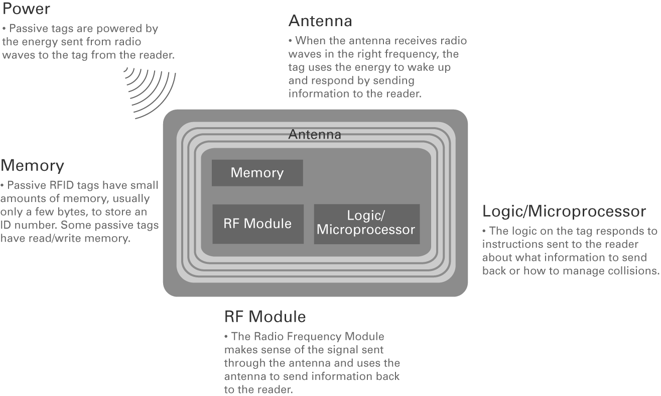
Basic RFID Tag (Passive Tag)
Notes:
A Passive Tag or Basic RFID Tag contains mainly only a few Elements, which are shown and described on the Slide.
Text for printed Version:
The passive RFID tag itself is essentially a small, self-contained sliver of electronic circuitry.
There is an element designed to store some digital ID information and another element that is designed to reliably transmit that ID at the moment a nearby RFID reader asks for it. Radio transmission always requires a certain amount of electrical energy, but instead of using a battery to store that energy within the tag, the tag’s circuitry is designed to soak up the energy it needs from the radio waves beamed its way by the RFID reader.
Thus, electronically, the tag remains asleep, entirely inert and inactive, until the moment it is bathed in radio waves, at which instant its circuit springs into action and automatically transmits a blip of pre-stored data to the reader that’s pointed its way. For this reason, RFID tags that are powered by external beams of radio waves are called “passive” tags.

Slide 12
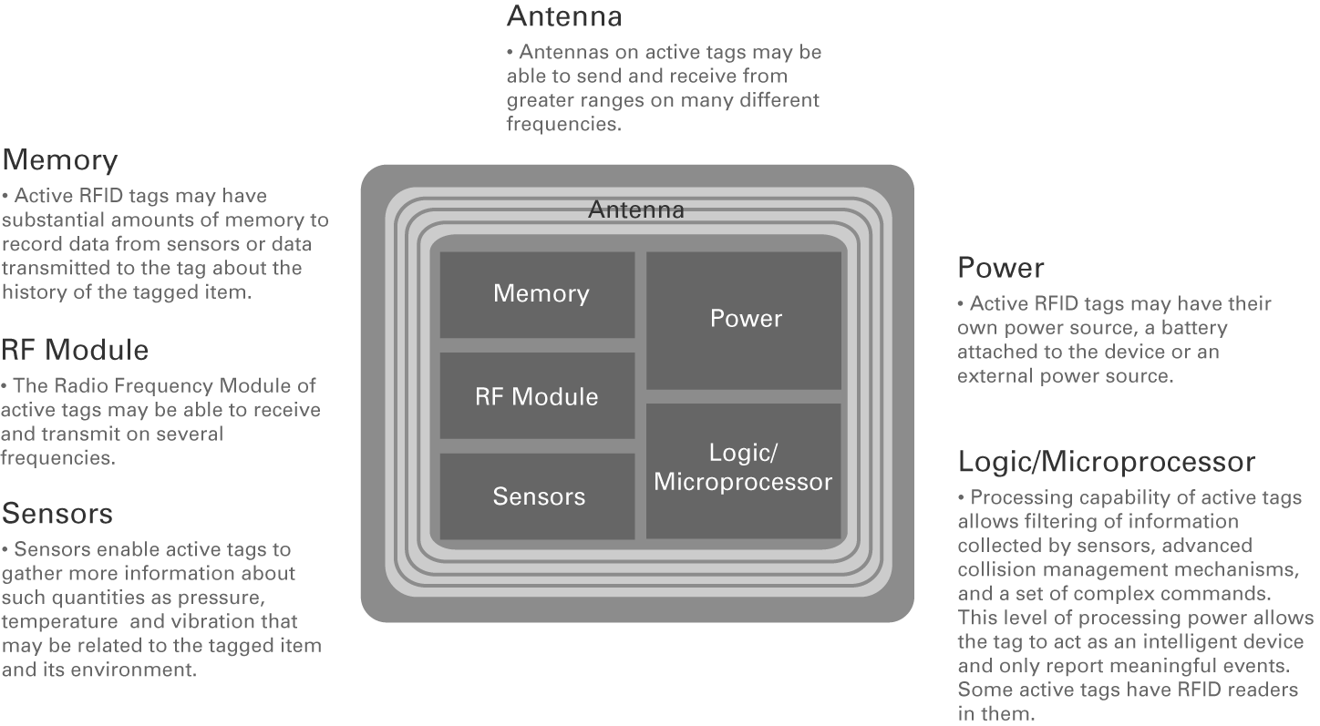
Smarter RFID Tag (Active Sensor Tag)
Notes:
An Active or Smart RFID Tag contains in addition a battery and often Sensors to measure the Temperature, Pressure or Vibration for Example.
Text for printed Version:
Smarter RFID Tags:
Different tags for different purposes
Advances in underlying technology and the creation of tags with their own power and more functions, so called “active” tags with the parts show in the Slide, will likely progress rapidly along all of the following dimensions.
Reading and Writing to More Memory
Some RFID tags can store only a fixed, pre-set ID number while others, costing more and relying on different internal circuitry, permit their internal data to be changed. An RFID reading device, in other words, can update their data on the fly, just by sending encoded radio waves that cause the tag to rewrite its onboard memory. Indeed, some rewriteable tags, as they’re called, are able to accept partial updates; their memories are divided into sections, each of which may be updated independently of the others. One potential application: members of a supply chain can read the data that upstream partners have written on an item’s tag but cannot change it. Yet, they can also only write to a pre-determined portion of the tag for the sake of downstream partners.
In fact, many RFID tags have sufficient capacity to store not simply an ID number but also much additional data about the items to which they’re attached. Such a tag might record the date and location of an auto engine’s original manufacture and the customer and car-type for which it’s destined. A beverage keg’s RFID tag might record the kind of drink – beer, milk, soda – that it was used for most recently. This data might help determine, based on local health regulations, the types of beverage that that keg would be legally permitted to carry next.
Some tags can actually store pages and pages of information – tens of thousands of bytes of data, that is. This capability is finding use in repair and maintenance. Instead of requiring field technicians to keep dozens of maintenance manuals on-hand, just so they’re sure to have the right one for any machine they may be called to fix, each machine can store its own manual in a “fat” RFID tag and carry a record of earlier repairs as well. To view the manual, which might even contain diagrams, workers need only bring an RFID-equipped personal digital assistant within range and call up the tag’s contents to their screen.
More Processing Power
Yet another improvement for RFID tag gös even further by not only storing strings of data but being able to make logical decisions – to act as a tiny computer, that is. In some tags, this logic is effectively “burned” into the circuitry in a permanent, unchangeable form. In other tags, a simple microprocessor is present, capable of running small programs that can be downloaded to the tag’s internal memory. The fixed-logic tags, sometimes referred to as employing a “state machine,” have the relative advantages of simplicity, lower cost, and lower power requirements. The tags with advanced microprocessors excel in their ability to accept updates, which can give those tags a longer useful life even as conditions and requirements change. The microprocessor tags consume a good deal more power than their state-machine cousins, however, which has implications for how they get used and packaged.
Sensors
In some cases, these “smart” RFID tags can be set up to collect data from sensors such as thermometers, accelerometers, or pressure gauges. And as RFID technology advances, it’s becoming possible to build sensors directly into tags, thus lowering costs and eliminating the need for technicians to wire separate circuits together.
Power on the Device
One of the most important aspects of RFID technology is power consumption. One major category of tags is “active,” meaning that the tags have a battery onboard to provide their circuits with electricity. On-board power gives these tags the ability to transmit information across wider distances than so-called passive tags, which get their power from incoming radio waves. Active tags can also contain considerably more complex circuitry, including more logic and more sophisticated sensors. Some active tags can operate for years without a recharge, broadcasting a short blip of data, say, every five minutes.
Sooner or later, of course, every battery wears out and needs replacing or recharging, and the cost of batteries is not trivial. Indeed, when thousands of tags are to be deployed, battery costs along may be prohibitive. So, there has been a great amount of attention focused on improving the technology of passive tags. Though simpler and somewhat restricted in terms of operating distance, these tags appear to be sufficient for the great bulk of RFID applications. And future advances in technology will surely make passive tags increasingly more attractive and useful.
Directional Sensors
In some applications, it’s useful to determine in which direction a tagged object was moving when it came into range of a reader. One solution to this problem is to set up two readers near each other and monitor the order in which a particular tag moves through their fields of operation. Another solution is to use a photölectric detector to detect the motion of the object while at the same time reading its tag to determine its uniqü ID.
Freqüncies
One of the key parameters affecting the capabilities of any RFID tag is the freqüncy of the radio signals it uses. Radio signals happen to behave quite differently depending on their freqüncy. (Consider, for example, the long distances that AM radio stations, operating at low freqüncies, can cover – as much as 1,000 miles, at night when interference is reduced -- compared to the 50-mile range of FM and TV stations, which operate at much higher freqüncies.)
In general, lower-freqüncy radio waves can travel further and penetrate solid substances more effectively than higher freqüncy signals. This can be of help in an RFID setup where it may be necessary to read tags no matter if they are situated behind a box containing some particularly dense material. It can also help extend the range of an RFID system: Low-freqüncy signals can effectively reach about 1 meter and still deliver enough power to activate a simple passive tag. On the other hand, lower freqüncy signals cannot carry as much information per second as those using higher freqüncies.
Demand is increasing, though, for “smarter” RFID tags, with onboard logic, and this requires higher freqüncy radio links. Their logic may be used to perform a calculation or to compare several pieces of incoming data – collected from a thermometer, for instance – and make a decision based on the results. As noted earlier, some tags have logic burned into them while others contain a simple general-purpose microprocessor. In either case, it is the freqüncy of incoming radio waves, sent by the RFID reader, that will determine just how quickly a tag will be able to execute its logic instructions. Just as a higher-freqüncy personal computer (as measured in gigahertz, or billions of internal clock cycles per second) can make a video game program run faster than a slower PC higher-freqüncy RFID tags can do more internal “work” and tackle trickier decisions each second than can lower-freqüncy tags. Instead of using an internal clock, however, passive tags will operate at the freqüncy provided by the radio signals that are sent their way.
Additional Informations:
Managing Collisions
A higher radio freqüncy can help solve one particular tricky technical problem in RFID. When more than one tag passes within range of an RFID reader of the sort at the same moment, it tends to be quite difficult to single out any particular tag and read its content and its contents only. The RFID reader’s beam of radio energy may activate many passive tags at once, causing all of them to transmit at once. With their many signals overlapping, it can be almost impossible to successfully read from or write to any single tag.
To fix this problem, engineers have worked out a variety of so-called anti-collision techniqüs. Tags may operate on different freqüncies, for instance. Or, more compelling from the point of view of cost and practicality, the tags may pick up on some split-second timing signals sent to them by the scanner and, using their internal logic, respond in a precisely-timed, non-overlapping manner. Clearly, this kind of communications protocol requires some fairly sophisticated and extensive software, and that calls for relatively high-freqüncy radio signals to speed the software’s execution along.
Freqüncy Ranges
Many early-generation tags have operated at the freqüncy of 120,000 Hertz – well below the AM radio dial in the U.S. But today, one of the most popular freqüncies for running RFID tags is 13.56 MHz, or about 13 and a half million cycles per second. This freqüncy is high enough to make a smart tag zip through some fairly involved software routines in a reasonable amount of time. This faster logic, moreover, helps with anti-collision protocols and can make it possible to read tags reliably even as they move past a scanning station at higher speeds than was possible before. This is particular useful in logistics, where it’s in no one’s interest to retard the movement of pallets or forklift trucks.
RFID systems based on so-called ultra-high-freqüncy (UHF) freqüncies (868 MHz in Europe and 915 MHz in the United States) offer a longer range and certain other advantages. They can communicate at distances of as much as 3 meters when used with passive tags and as much as 15 meters with active, internally-powered tags. That has obvious advantages for certain applications.
Going a step further up the radio dial, we reach the 2.4GHz band, known as microwave, which offers the highest possible data transmission and processor clock rates. Microwave tags can perform quite complex calculations. Chemical containers, for instance, can be programmed to recognize each other and set off a safety alarm if they determine, autonomously, that more than, say, four containers happen to be located within a certain radius of each other.
This ultra-high freqüncy also means that tags and base stations can move quite quickly relative to each other with no loss of reliability or accuracy. Maximum speeds of as much as 400 km/h (240 mph) have been achieved in highway traffic-related applications. At this freqüncy, however, active tags are by and large a must, dü to high power requirements. The range of these tags is significantly greater, too: 10 to 15 meters is realistic, and even greater ranges have been achieved in the field of traffic management. Automatic toll systems on highways, for example, can use UHF signals to transfer identification data over distances of as much as 50 meters. One negative factor is that UHF signals are even weaker than 13.56MHz signal when it comes to penetrating most materials.
Sensors
Finally, with enough onboard processing power, an RFID tag can serve not only to store and report on internal data but also to collect and transmit “live” information from physical sensors, too. An entire range of sensors can be built into electronic labels, measuring such parameters as temperature, humidity, air pressure, shock, acceleration, and even light intensity and pH valüs. So far, however, this is more theory than practice, dü mainly to issüs of cost. Electronic tags with built-in sensors are not used widely today because the sensors themselves tend to consume too much power. Sensors and their associated electronics in a tag can consume anywhere from 10 to 1,000 times more energy than passive RFID tags – those that take their power from incoming radio waves, that is – are able to provide. As a result, sensors have mainly been used in active systems whose tags each have their own onboard battery.
In short, no matter what the requirements are for a particular application, there’s likely to be an RFID tag that’s just right. And if there isn’t, there’s a lively RFID industry emerging that’s prepared to design and produce just about any customized tag that might be needed.
RFID Data Storage
Different storage technologies have different properties and, no surprise, different costs. In many RFID applications, simply being able to read the data stored in a tag is sufficient. But in some situations, it’s helpful to be able to remotely write new data to a specific tag. As a finished product leaves a factory, for instance, the date of its production may be written to the tag.
Not surprisingly, a storage medium that can accept updates will be somewhat more complex and costly than one that permits reading only. To write data into a semiconductor memory, for instance, requires a certain amount of electrical energy, so writeable tags, as they’re sometimes called, must either contain a battery to supply power or use circuitry that can extract the required energy from incoming radio waves. Batteries, of course, do not last forever, so battery-powered tags have a finite lifetime – sometimes stretching to several years, given the right battery and an application that dösn’t require the tag to be activated too often.
There are several varieties of read-only semiconductor memory technologies, each of which is finding use in some corner of the RFID market:
EEPROM: Electrically-erasable programmable read-only memory dös not require a continuous power supply to store data. The power required to read information from an EEPROM is quite small. . Rewriting the data within individual EEPROM cells requires significant energy, however, which limits to how far a passive EEPROM-based tag may be from a transmitter. Also, EEPROMs can’t be updated limitlessly. Depending on their design, they can accept a maximum of 100,000 to 1,000,000 rewrites.
SRAM: Static random access memory has the advantage of being able to change its contents much faster than EEPROMs. The downside is that they require continuous power, without which they “forget” any data they may have been storing. That means incorporating a battery in SRAM-based tags, which leads to higher cost and weather-related limits; batteries don’t work well in extreme cold, for instance.
FRAM: Ferromagnetic random access memory is a comparatively new technology and as yet is little used. It combines some of the advantages of SRAM and EEPROM.
Memory Capacity
RFID tags vary in memory capacity from a mere 32 bits (equal to 4 bytes, or 4 characters of information) to as much as 32,000 bytes (or 32 kilobytes). In general, the less data a tag carries, the further away from a reader it can be and still be interrogated reliably
Low-end tags range in capacity from just 32 to 80 bits. These low-capacity tags are designed to store only an identification number, but by using the full 80 bits of binary coding that number can range from 0 to 1.2 x 10^24 -- enough to give a vast number of items uniqü IDs.
Another variety of tag stores 80 to 256 bits, using primarily EEPROM and RAM memory technology. These tags can include small amounts of explicit information encoded in a sort of numerical shorthand: Just as airlines refer to the Newark, NJ, airport as EWR, for instance, these tags might use a few binary 1s and 0s to signify a lengthy product number or customer name. Only a computer with the right decoding software can make sense of such data.
SRAM-based tags with 32 to 256 bytes of capacity, while FRAM technology can store as much as 32,000 bytes. These types of memory can store information as alphabetic letters as well as binary-based codes. In fact, 32 kilobytes is enough to store some 11 pages of standard, double-spaced text. Such capacity makes it possible to store in explicit form highly detailed information, such as complete maintenance instructions for a component of a larger assembly. Just like the other kinds of memory technology, however, SRAM and FRAM don’t escape the challenging technical tradeoffs between memory capacity, operating range, and power consumption.
State machine vs. Microprocessor
Every RFID tag contains logic circuitry whose job, at minimum, is to control the movement of data within the tag. In sophisticated tags, however, such logic can be used for sophisticated purposes: A tag may section off its total memory, permitting only readers that supply the proper passwords to update particular sections – a capability that might prove useful in a supply chain involving multiple parties. Whether it’s simple or complex, a tag’s logic may be implemented in the form of a so-called state machine or as a programmable microprocessor. Each has its pros and cons.
The state machine is the most popular form of logic in today’s tags. State machine is simply a technical term for a circuit that is designed to perform some pre-set seqünce of logical instructions – an algorithm, that is – and nothing else. The state machine uses little power and is quite efficient in operation, and in high volumes it can be produced at relatively low cost per unit of logic. Its computing power makes it useful for handling such tasks as encrypting data, controlling access to a tag’s memory via passwords, and executing the complex hand-shaking protocols that are required to prevent multiple tags from interfering with each other when they’re all scanned at once. The state machine has the distinct disadvantage, however, of being hard-wired; its logic cannot be changed after fabrication.
Enabling that kind of logic modification is exactly where the microprocessor shines. It is a general-purpose computer, in essence, that can execute any string of software instructions it is given. With a microprocessor, an RFID tag can perform fairly sophisticated tasks, such as monitoring and analyzing inputs from several outboard physical sensors. In some applications, such a tag may actually run its own tiny operating system, which could be useful in making the tag’s software, as well as its data, modifiable from afar. Tags used for tracking maintenance of equipment in hard to reach places is an excellent application of this techniqü. Readers can send instructions to update tags on such equipment without having to get close to them. Microprocessor-based tags consume more energy than their state machine counterparts, however, and that can limit their ability to communicate with scanners across long distances.

Slide 13
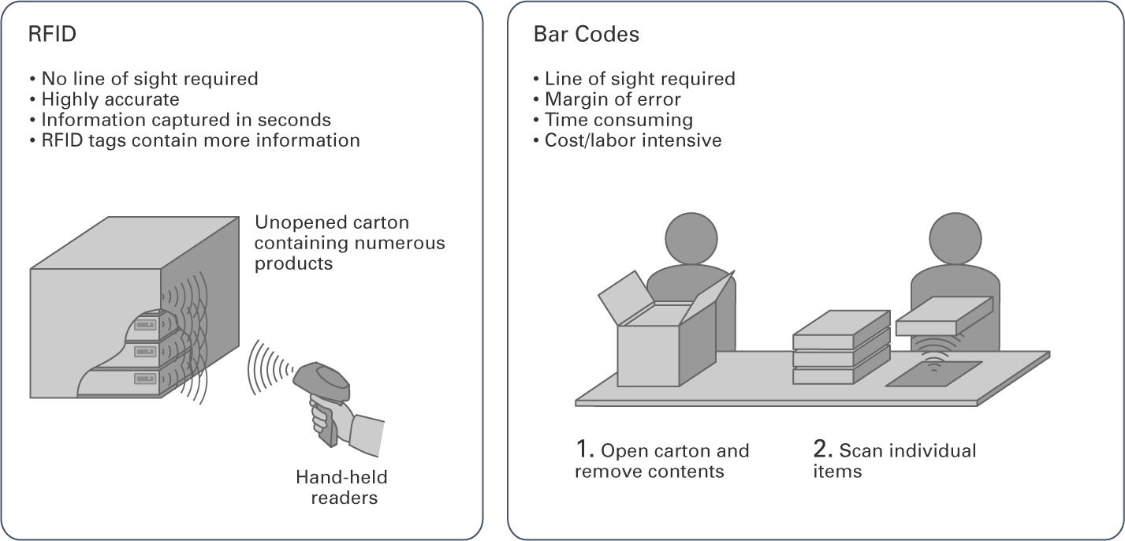
Bar Codes Versus RFID Tags
Notes:
This slide describes the advantages of RFID in comparison to Bar Codes. The main advantage is that RFID needs NO line of sight. In addition an RFID contains more information and you can change or write new Data many time on the tag.
Text for printed Version:
Indeed, barcodes have long helped make the computer-based tracking of items possible, through every stage of the typical supply chain. And that technology is hardly about to disappear overnight. Its extremely low cost will be tough to beat in many applications. But RFID offers some quite significant advantages: To capture the data encoded on a barcode label requires that the label itself come within a certain distance and in direct line of sight of an optical reader. This is necessary because to read a barcode requires scanning its inked pattern with a focused beam of laser light.
RFID tags, on the other hand, need only to be reached by radio waves for their data to be captured. And radio waves, it turns out, are effective at greater distances than the barcode scanner’s laser – at least a few feet and in some cases 10 yards or more. What’re more, radio waves can pass unobstructed through many of the common materials used to produce and to package consumer and industrial goods – paper, cardboard, plastic, styrofoam, wood, and so forth. So, in a factory or truck-loading situation, there’s much less effort required, if any, to position each object in a precise way just so its RFID tag can be read.

Slide 14
”Electronic Product Code“ (EPC)
Notes:
The Electronic Product Code (EPC) contains of the 4 Sections.
Here’s how the code works: Its digits are organized in four sections.
From left to right, the first section indicates which version of the EPC specification is being used.
Next comes a number indicating the corporation that created the tag, which is usually the same organization that produced the item to which the tag is attached.
The third section denotes the so-called object class of the product: Here, a soda can’s tag might carry a number indicating that it’s a “Cherry Coke, 12-oz. can, U.S. version.”
Finally, there’s a uniqü nine-digit serial number assigned to a specific can of Cherry Coke. With nine digits to work with, it’s possible to assign uniqü IDs to no less than 999,999,999 different cans.
The Electronic Product Code (EPC).
Building off a decade of research at MIT’s Auto-ID center and now managed by a joint venture called EPCglobal™, the EPC effort attempts to introduce a suite of coherent specifications and protocols governing both RFID hardware and software and the formats of the data that they will exchange, store, and process. Of all the standards used in the implementation of Real World Awareness technologies, EPC is perhaps the most crucial. Much as the HTML and HTTP standards enabled the World Wide Web to take off, EPC is hoped to greatly reduce incompatibilities in the RFID world and help the technology gain widespread acceptance and usage.
The Auto-ID team began with the assumption that RFID would fail to take off commercially until the cost of chips and readers fell dramatically – from 50 cents apiece to less then 5 cents for the former, and from $1,000 to around $100 for the latter. The team also resolved to create a complete standard around which all RFID makers could rally, thus creating economies of scale and driving down costs.
The goal was to create an “Internet of things,” in which every object, at the moment of its “birth,” or production, could be imprinted with an RFID chip containing an EPC-defined ID number, or code. This EPC code itself is only a string of binary digits – a 64- or 96-bit number (future versions will be 128-bits and 256-bits in length). It merely identifies an object uniqüly and points to a database server somewhere on the Internet where data about that particular object can be found. Rather than cramming data onto the chip itself – which would increase its cost and size – the Auto-ID team’s key innovation was to offload that data onto networks where storage is cheap, plentiful, and easily accessible. Besides the code itself, the EPC framework includes specifications for tags and readers, as well as for a variety of software needed to manage billions of codes, look up information attached to them, and so forth.
The Auto-ID team’s vision was that every object tagged this way could be found and have its status tracked remotely as it moved along the supply chain from the moment of its manufacture to the disposal of its packaging by the end user. To that end, the proposed EPC standard also includes specs for the creation of tiny, low-powered tags capable of containing only EPC codes (thus lowering the cost) and the inexpensive RFID readers needed to read them.
The EPC itself is a 24-digit alphanumeric string (it combines numbers and letters, that is) that can be expressed inside computers as 96 bits of binary data. It alternately functions, depending on your choice of metaphors, as a license plate number, an IP address, or a super bar code designed to do two things: be uniqü, and point to a data file in a computer somewhere on the Internet. This file, sometimes referred to as metadata, contains information about the object that the code uniqüly identifies. Thus, the code and this server work hand-in-hand to provide the full capability of the EPCglobal™ scheme. The EPC code itself contains no explicit information about the object to which it is attached.
Here’s how the code works: Its digits are organized in four sections. From left to right, the first section indicates which version of the EPC specification is being used. Next comes a number indicating the corporation that created the tag, which is usually the same organization that produced the item to which the tag is attached. The third section denotes the so-called object class of the product: Here, a soda can’s tag might carry a number indicating that it’s a “Cherry Coke, 12-oz. can, U.S. version.” Finally, there’s a uniqü nine-digit serial number assigned to a specific can of Cherry Coke. With nine digits to work with, it’s possible to assign uniqü IDs to no less than 999,999,999 different cans.
Different types of tags: class 0, class 1 gen 1 and class 1 gen 2
The feature sets of the EPC’s RFID specs are continually evolving. The two most commonly used today are the original spec, referred to as “Class 0,” and the more refined spec called “Class 1 Gen 1” The latter, still awaiting approval, adds several new capabilities, including the ability to instruct RFID tags to “kill” themselves.
Class 0 tags are the EPC’s vanilla, standard-issü tags. These are tags that have been given random, non-company-specific EPC codes by their manufacturer and sold for use in a supply chain. It’s up to the each corporate customer to assign tags to its own physical products and then enter that assignment into a corporate database for tracking. It’s useful to think of Class 0 tags as a license plate issüd by a manufacturer instead of the state – the number is uniqü, but it’s up to the driver to associate it with a particular car. Until recently, EPC specs allowed for Class 0 tags to operate at either 13.56 MHz or 915 MHz, but the lower freqüncy variation has been mothballed for the foreseeable future.
Class 1 Gen 1 tags, also referred to as Class 1.1 tags, can be thought of as license plates issüd without a number, only the official markings, thus granting the owner the opportunity to assign his own number to the plates. Class 1.1 tags can be written once and read many times via the EEPROM process, enabling companies to imprint tags with their uniqü EPC Manager IDs and otherwise map tags to physical products.
Class 1 Gen 2 tags, or Class 1.2 tags, add the ability to rewrite each tag’s contents many times, plus several new protocols missing in earlier versions: One is the “kill” feature, in which tags may be ordered to erase their data and burn themselves out in order to prevent future reactivation and reading. Among other uses, this feature may go a long way in reassuring consumers who are wary of RFID tags’ potential threat to personal privacy – particularly concerning the idea that government agencies or marketers might surreptitiously scan individuals or their homes to learn about the products people are wearing or have taken home from the store.

Slide 15
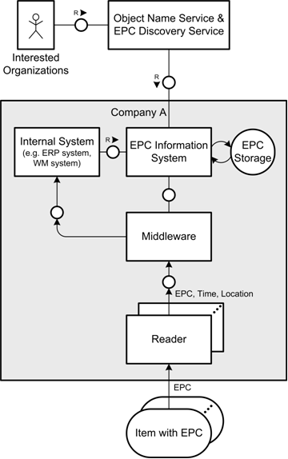
EPCglobal Network Architecture I / II
Issues
Interfaces to other external companies
Additional IT components
Security of infrastructure
Tremendous volume of incoming data
Capacity limits of
Network links
Database systems
Processing power
ERP system

Slide 16
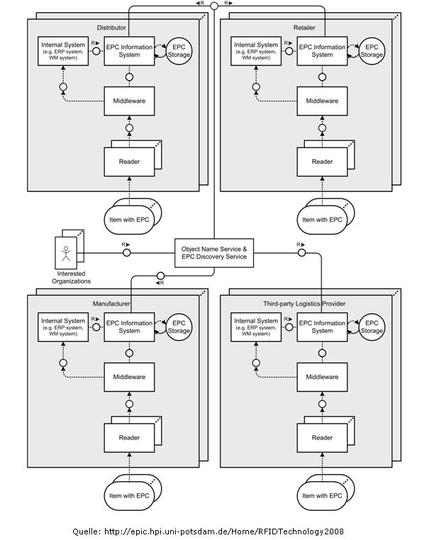
EPCglobal Network Architecture II / II
Issues
Data exchange between supply chain parties
Information retrieval from unknown resources
Dynamic trust relations

Slide 17
How does RFID support Flexibility?
RFID bridges the gab between physical and digital world
Real-time awareness
Transparency throughout the supply chain
Real-time control of object flow
Data capture
Higher quality, accuracy
Higher quantity
Higher degree of integration
Automatic integration of enterprise information systems
Integration of new, innovative information systems
Higher degree of automation
Data capture without the line of sight
Automatic triggering of business processes

Slide 18
Vielen Dank für die Aufmerksamkeit!
Fragen?
Weitere Informationen auf http://epic.hpi.uni-potsdam.de/Home/RFIDDataProcessing2011
(EPIC --> Teaching --> Master Curriculum Winter Term 2011/12)

Slide 19
Soviel zur Einführung in die Thematik!
Fragen?
Nun zur Vorstellung der Projektseminarthemen...

Slide 20
Seminar Topics
Responsible: Martin, Jürgen
GraphML for modeling complex supply chains
SAP OER on NewDB
Parallel distributed supply chain simulation
Tracing and Filtering Algorithms on NewDB
Responsible: Matthieu
Management of fine-grained authentication details in EPC information service
Policy Administration with History-based Access Control for EPC Information Services
Responsible: Christian
Track and Trace RFID Data on RAMCloud

Slide 21
Topic 1
GraphML for modeling complex supply chains
Problem: sophisticated operations, such as analyzes and simulation of supply chains need a proper model, which can be leveraged for automatic processing
Hypothesis: GraphML provides means to define a model for complex RFID-enabled supply chains that can be used for automatic processing
Tasks to solve:
Understand the concept of GraphML
Understand the building blocks of global distributed supply chains
Extract supply chain characteristics from these findings
Define a GraphML-based model for complex supply chains

Slide 22
Topic 2
SAP OER on NewDB
Problem: Performance of SAP’s OER (EPCglobal compliant EPCIS) is not sufficient for most companies’ requirements
Hypothesis: Request processing time of OER is dominated by DB performance. NewDB can improves insert and query performance.
Tasks to solve:

Slide 23
Topic 3
Parallel distributed supply chain simulation
Problem: Simulation of complex event interactions, based on given supply chain model
Hypothesis: Parallel, distributed event simulation can perform simulation results in realistic sizes in reasonable time
Tasks to solve:
Get familiar with existing event simulator (developed last semester)
Develop concept how to distribute the simulation of events
Prototypical implementation

Slide 24
Topic 4
Tracing and Filtering Algorithms on NewDB
Problem: Data transfer and computation outside of NewDB is a performance critical task
Hypothesis: NewDB provides programming interfaces (L,R, BFL, SQL-Script) that provide a better performing alternative to outside DB calculations
Tasks to solve:
Get acquainted with Discovery Service tracing and filtering algorithms
Analyze NewDB programming interfaces
Prototypically implement algorithms on NewDB
Compare and evaluate results

Slide 25
Topic 5
Management of fine-grained authentication details in EPC
information service
Problem: what is an appropriate level of granularity for authentication of individuals, e.g. per company, per department, per floor, etc.
Hypothesis: the use of individual authentication details per supply chain participant can reduce impact of key exposure
Tasks to solve:
Learn to work with and extend our fosstrak in-memory prototype
Learn to measure and interpret benchmarks
Show that in-memory technology is applicable for very fast key/license lookup
Multiple key renewals per day are feasible
Malicious clients can be blocked individually in case of disasters without affecting operation of remaining supply chain participants
Implement key renewal with the help of in-memory prototype

Slide 26
Topic 6
Policy Administration with History-based Access Control for EPC Information Services
Problem: user needs to define abstract rules via user interface in a convenient way
Hypothesis: using modern interactive user interface elements reduces efforts for unskilled users to create access rules and to automatically create rule set from them
Tasks to solve:
Learn to work with and extend our fosstrak in-memory prototype
Learn to define rules as XML dialogue, e.g. ODRL, XACML, etc.
Develop user interface for administration of access rules
Develop filters from defined rule sets (Python)
Apply filters to extend functionality of existing fosstrak in-memory prototype
Benchmark performance of developed filters

Slide 27
Topic 7
Track and Trace RFID Data on RAMCloud
Problem: RFID-based product tracking produces large amounts of data which have to be analyzed within seconds
Hypothesis: RAMCloud – a scalable distributed in-memory storage system – is suited for handling the involved data processing
Tasks to solve:
Create a partitioning schema for RFID data on RAMCloud
Implement a ”Trace Operator” on RAMCloud for retrieving the shipment history of a single product
Execute benchmarks with a realistic workload on 10+ nodes
Evaluate the ease of scaling out your solution

