Slide 1

Ab Initio Protein Structure Prediction
The Folding Problem
Tamara Slosarek & Jan Ladleif
Trends in Bioinformatics
02.02.2016
Notes:
welcome to our expert session!
today we will talk about protein structure prediction
or the infamous “Folding Problem”
let’s start slowly, though

Slide 2
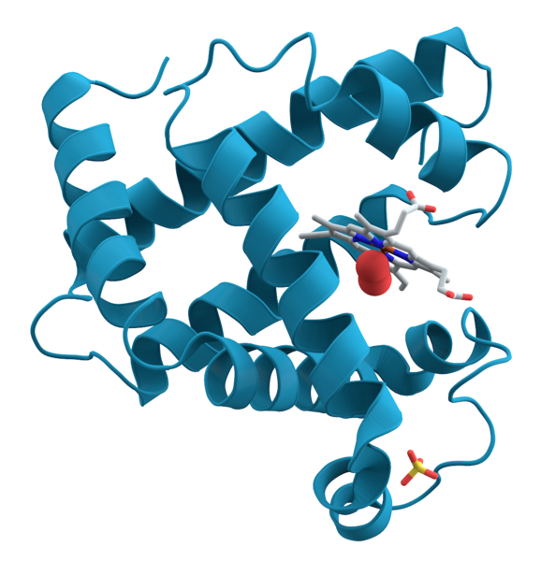
Proteins
What are they good for?
Notes:
proteins: you have probably already heard of them
maybe even seen those nice pictures
proteins are also called molecular machines.
they have important tasks in our body
for example...

Slide 3
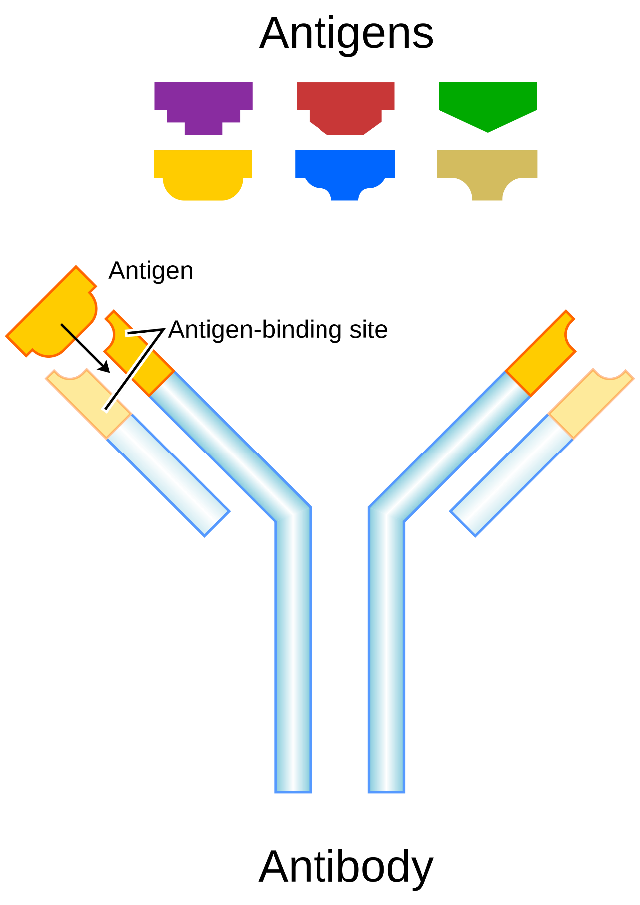
Proteins
What are they good for?
antibodies
Notes:
antibodies!
Y-shaped proteins that are used by the immune system
they identify and neutralize stuff like bacteria and virusses
identifies the harmful agent, the antigen, by their specific structure
much like a key and keyhole!
Pic: https://en.wikipedia.org/wiki/Antibody and http://medicalxpress.com/news/2015-02-antibodies-lab-higher-quality-dna.html

Slide 4
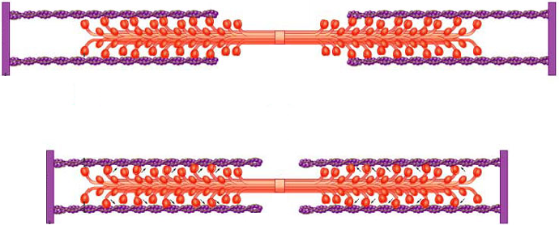
Proteins
What are they good for?
antibodies
muscles
Notes:
muscles!
might have heard of that in school, popular example there
actin and myosin (middle) work together to produce movement
without them, we could not move at all!
Pic: https://www.somasimple.com/images/myosin.jpg

Slide 5
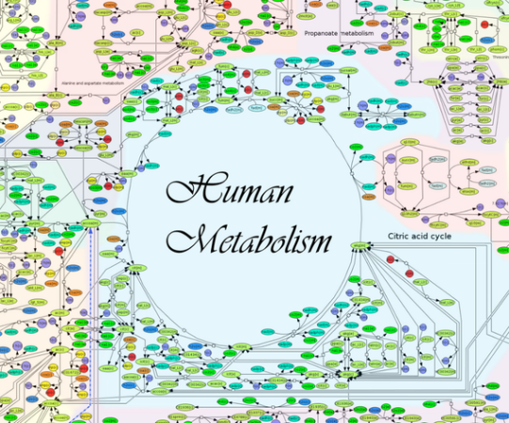
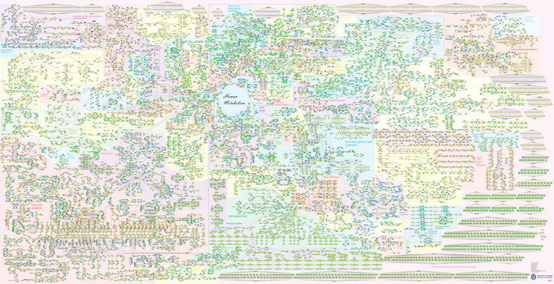
Proteins
What are they good for?
antibodies
muscles
metabolism
Notes:
metabolism!
you probably have a good metabolism, otherwise you wouldn‘t be here so early
basically the whole energy budget in your body
from breaking down matter to building up matter
metabolism is a complex system that is mainly governed by proteins
don‘t worry, the whole picture is not important
all in all, quite impressive what proteins can do...
Pic: https://vmh.uni.lu/#mapnavigator

Slide 6
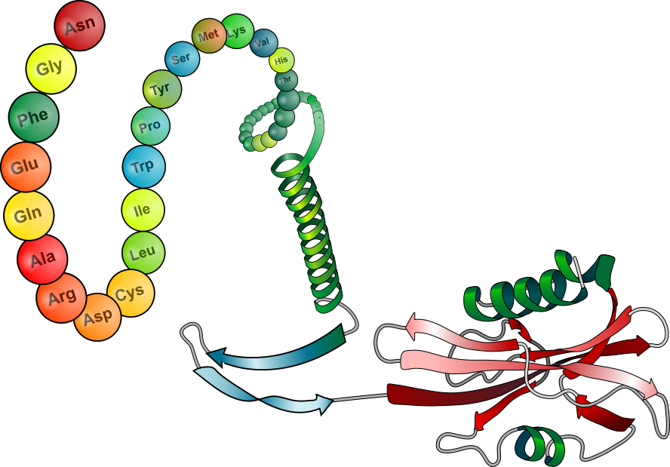
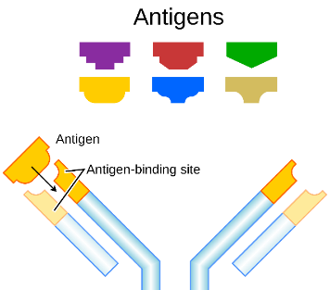
Protein Structure
Primary Structure
Amino Acid Sequence
Secondary Structure
Regular Sub-Structures
Tertiary Structure
Three Dimensional Structures
Notes:
... but how can proteins do so many different things?
to answer that question, we have to dive deeper into their structure
how are they build, what are the different structures?
... go through structures...
tertiary structure: remember antibodies!
all of this is determined by complex physical interactions
why is it important to know the structure? for what does it matter?

Slide 7

Medical Relevance
tertiary structure is essential to know in drug design
Notes:
it is quite a huge deal in medicine!
drug designers use knowledge of target proteins to directly adapt drugs to a specific target
they can be made more efficient
side effects can be reduced
and whole new drugs can be developed!

Slide 8
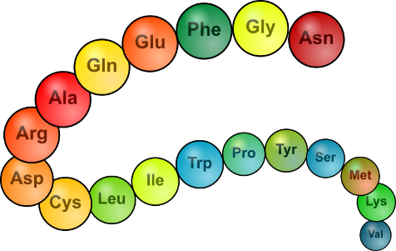
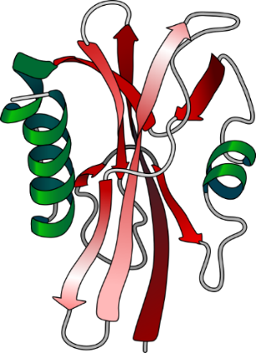

Protein Structure Prediction
Scientist A
„Hm, I could really improve this drug, if I knew this one protein‘s structure...“
Scientist B
„No problem, just give me a few minutes...“
$$⋮$$
„Here you go!“
✓
Notes:
optimally, we would be able to determine the structure of any protein
in a lab environment, this would be enourmously helpful
how we can do this will be the topic of our session

Slide 9
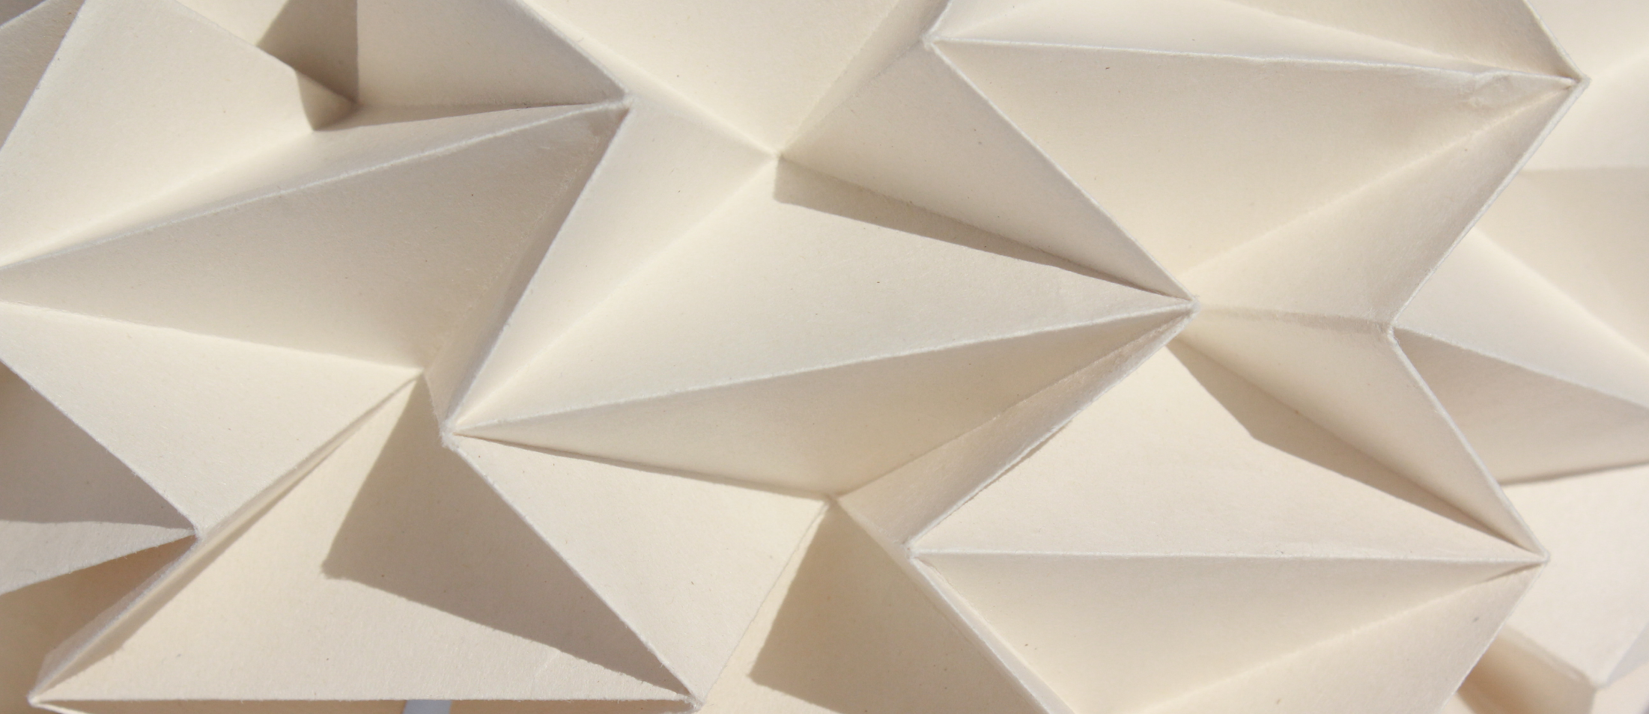
Agenda
Introduction to Proteins
Physical Structure Determination
Ab Initio Approaches
  QUARK
  I-TASSER
Prediction Quality
Outlook
Notes:
go through agenda
Not too much

Slide 10
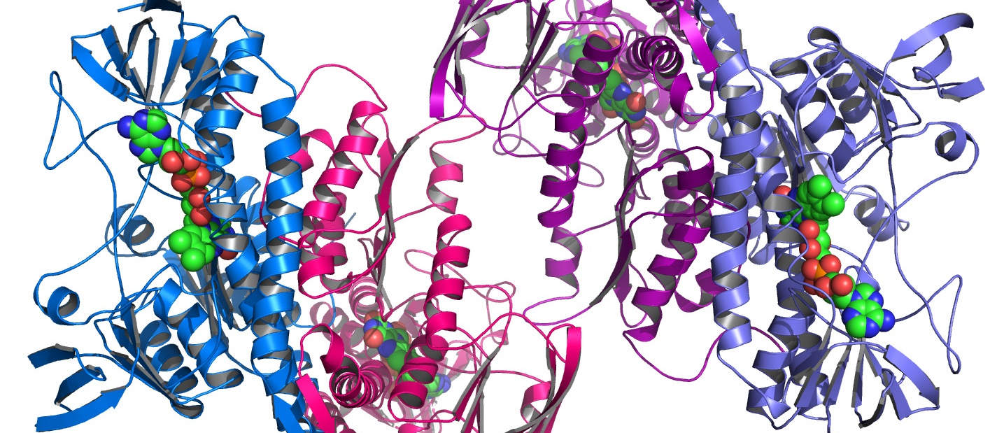
Introduction to Proteins
Introduction to Proteins
Physical Structure Determination
Ab Initio Approaches
    QUARK
    I-TASSER
Prediction Quality
Outlook
Notes:
What are proteins
Why do they fold at all
Ask questions
Image from http://www.tuscany-diet.net/wp-content/uploads/2015/04/protein-structure.jpg

Slide 11
Overview
Protein Structure
Secondary Structure
Regular Sub-Structures
Tertiary Structure
Three Dimensional Structures
Primary Structure
Amino Acid Sequence
Introduction to Proteins
Notes:
Jan already gave you an overview of the structure
start directly with the primary structure and where it comes from
Image modified from https://commons.wikimedia.org/wiki/File:Main_protein_structure_levels_en.svg

Slide 12
Primary Structure
From DNA to Proteins
transcription
DNA
mRNA
Introduction to Proteins
Notes:
DNA encodes primary structure
DNA‘s coding strand is copied into messenger RNA (gene expression)
Similar to DNA, transports information to cell organelles called ribosomes

Slide 13
Primary Structure
From DNA to Proteins
amino acid chain
tRNA
mRNA
anticodon
& codon
translation
Introduction to Proteins
Notes:
mRNA is translated into the encoded amino acid
Three nucleotides → codon
Codon → anticodon & amino acid @transfer RNA
Protein synthesized.

Slide 14
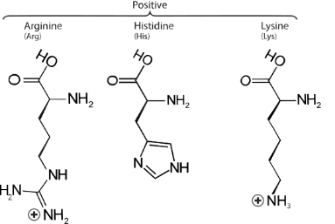
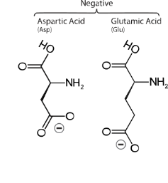
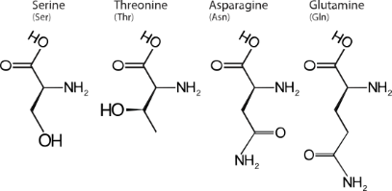
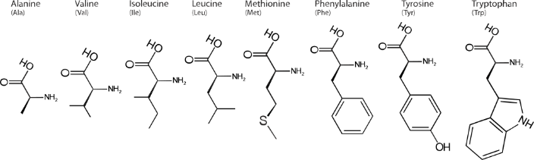
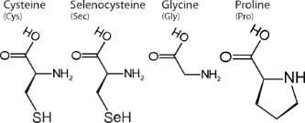
Primary Structure
Amino Acids
Electrically Charged
Hydrophilic (Polar)
carboxyl group
amino group
Hydrophobic (Nonpolar)
Special Cases
residue
Introduction to Proteins
Notes:
21 different amico acids in the human body
basic structure is the same, residues differ
different categories have different effect on the structure
[Additional information regarding special cases]
Cysteine: Thiol group, able to form disulfides
Selenocysteine: Catalytic properties (often found in enzymes)
Glycine: Fits into hydrophobic and hydrophile environments, can adapt both properties
Proline: Amino group is bound twice, opposite to Glycine‘s function
Image modified from https://upload.wikimedia.org/wikipedia/commons/a/a9/Amino_Acids.svg

Slide 15
Primary Structure
Amino Acids
Introduction to Proteins
Notes:
The chain forms by a chemical reaction of the carboxyl and the amino group
Chain without residues is called backbone

Slide 16
Overview
Protein Structure
Secondary Structure
Regular Sub-Structures
Tertiary Structure
Three Dimensional Structures
Primary Structure
Amino Acid Sequence
Introduction to Proteins
Notes:
Primary structure folds into regular sub-structures

Slide 17
Secondary Structure
Common Regular Sub-Structures
α-helix
β-sheet
β-turn
Introduction to Proteins
random coil
Notes:
most common
No specfic secondary structure random coil

Slide 18
Secondary Structure
Hydrogen Bonds
atomic bond > intermolecular coupling
hydrogen bonds > dipol-dipol > van der Waals
Introduction to Proteins
Notes:
Most important in secondary structure
Between hydrogen and two electronegative atoms in hydrophilic residues
Electronegative: …
- + - → jumping between
No atomic bond but strongest intermolecular coupling

Slide 19
Overview
Protein Structure
Secondary Structure
Regular Sub-Structures
Tertiary Structure
Three Dimensional Structures
Primary Structure
Amino Acid Sequence
Introduction to Proteins
Notes:
regular sub-structures and random coil fold again

Slide 20
Tertiary Structure
Interactions Between Residues
interactions between hydrophobic residues and water
ionic bond
(between electrically charged redidues)
disulfide bond
(between cysteine residues)
Introduction to Proteins
Notes:
Most important interarctions
Hydrophobic cluster inside the protein
Ionic
Disulfide → atomic bonds (strong)

Slide 21
Tertiary Structure
Folding of NTL9
VIDEO
Introduction to Proteins
Notes:
Although it takes several seconds, actually milliseconds
Not sequential secondary → tertiary but everything at once
Several intermediate steps
In the end the most stable structure forms

Slide 22
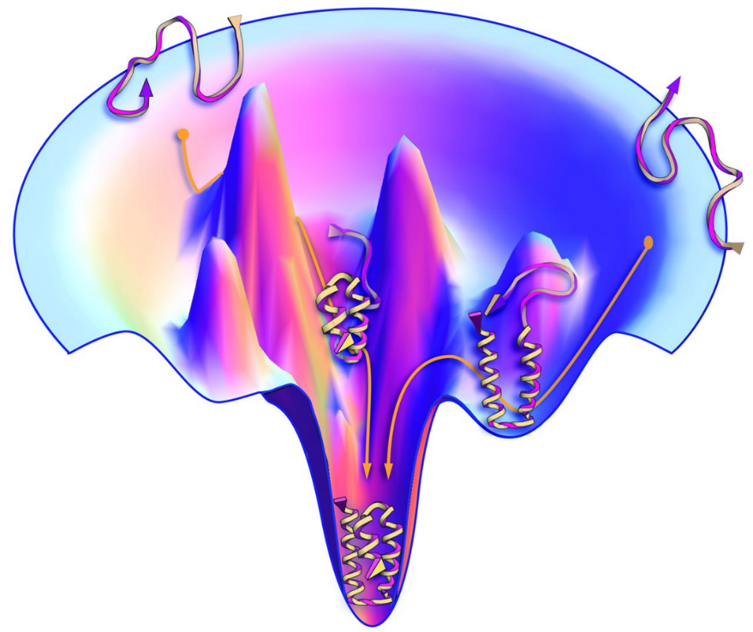
Tertiary Structure
Energy Landscape
energy
Introduction to Proteins
Notes:
Mapping: possible conformations against energy level
Most stable structure (native) lowest energy level

Slide 23
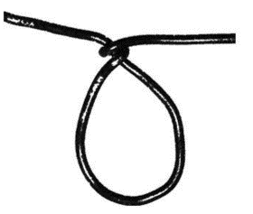
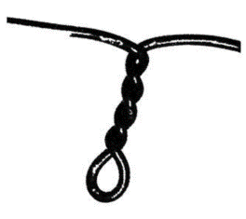
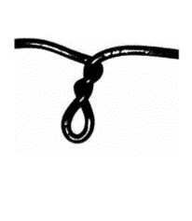

Hands-on
Fold Your Own Protein
positively
charged
negatively
charged
hydrophobic
… leave a space of three fingers
between the residues.
Introduction to Proteins
Notes:
Let‘s fold our own proteins
[PASS WIRE]
[PASS HANDOUTS]

Slide 24
Hands-on
Fold Your Own Protein
Phe – Trp – His – Val – Ile – Glu – Ala – Leu – Lys – Met – Asp
Introduction to Proteins
Notes:
[WAIT FOR EVERYONE TO BE READY]
What do you think, is the best position for hydrophobic residues since in cells there is a lot of water?
And now, what happens with the electrically charged ones?
Hope for question, which ions to which… that‘s exactly the point
This is one option to find a possible structure to a amino acid sequence, Jan will now show you how it is done experimentally.

Slide 25

Physical Structure Determination
Introduction to Proteins
Physical Structure Determination
Ab Initio Approaches
    QUARK
    I-TASSER
Prediction Quality
Outlook
Notes:
of course there are several ways to get the protein structure
one of them is to go through a lab and use physical methods
I want to show you two of them!

Slide 26
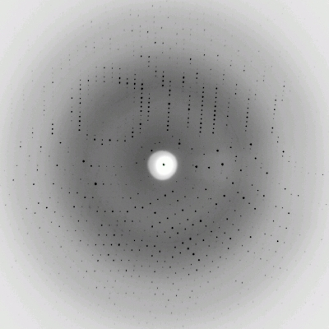
X-Ray Crystallography
mix concentrated sample of proteins and other additives
crystallize it and obtain a nice crystal
use X-Rays and analyse the crystal‘s diffraction pattern
calculate structure from the diffraction pattern
Notes:
first of all, we need a sample of our protein
this sample must be highly concentrated
then, a number of different addititves need to be added
together they form a crystal that is made up of the protein
using X-Rays, this crystal produces a characteristical diffraction pattern
this pattern can be analysed by a computer to get the structure
because this sounds quite complicated, let watch it as a video again
Pic: http://course1.winona.edu/kbates/bio241/images/figure-11-04.jpg

Slide 27

X-Ray Crystallography
Limitations
complex proteins lead to fuzzier pictures
crystallization process is very complicated:
  very difficult to predicts best conditions
  trial and error to find right solutions
  sensitive to temperature and shocks
not all proteins are crystallizable
Notes:
however, crystallography is not suited for every protein
some are too complex and the diffraction patterns get too fuzzy
also, the crystallization itself is extremely difficult, might take days and weeks
it must occur in perfect conditions which are always different
a lot of trial and error is needed to find the right additives
small changes in temperature or shocks can destroy the crystals
and not all proteins are crystallizable

Slide 28
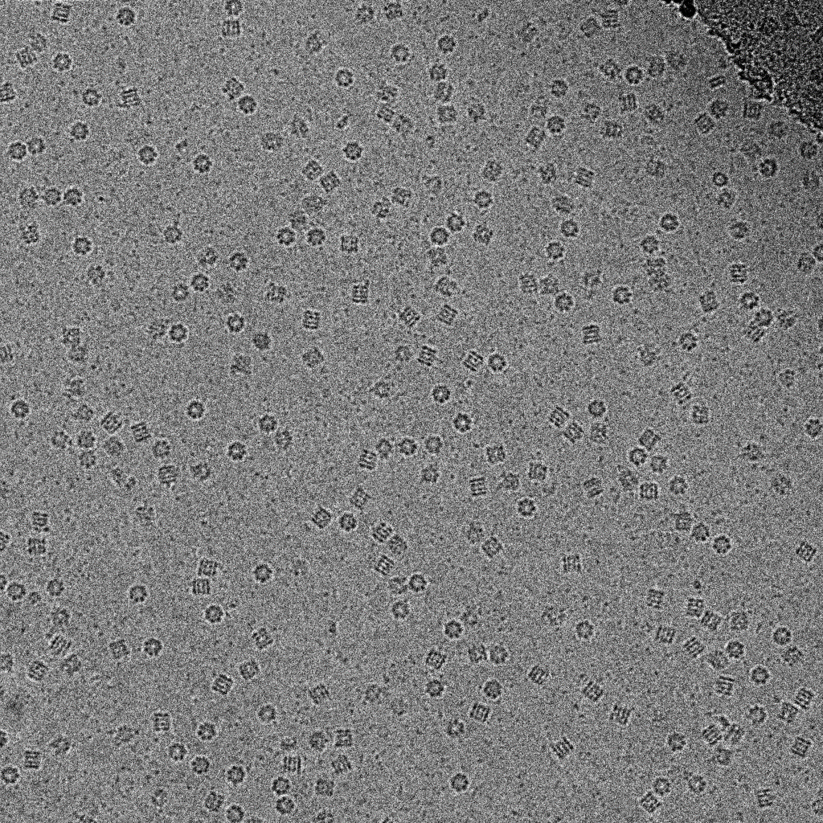
Cryo-Electron Microscopy
get liquid solution of the protein
press into thin layer and freeze rapidly
put matrix under an electron microscope
images are categorized according to
their orientation
images of the same orientation are combined
all different orientations are combined
into 3D structure
Notes:
a different approach
we again get a liquid solution of the protein
then, we press that into a thin layer and freeze it rapidly
put that as a matrix under an electron microscope
categorize the pictures of the protein based on the orientation
images of the same orientation are combined and refined
different orientations can be combined into 3D structure
let‘s take a look at an example...

Slide 29




Cryo-Electron Microscopy
Example
Physical Structure Determination
Notes:
imagine the protein to be a torus
then the pictures might look like this
kind of blurry, but you get the idea!
we can make out three orientations
these are then categorized...

Slide 30

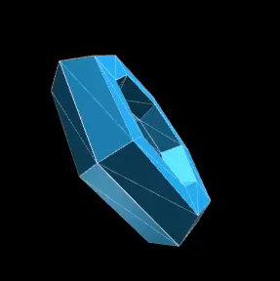
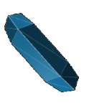

Cryo-Electron Microscopy
Example
Physical Structure Determination
Notes:
then, the blurry images from each category are combined
together they have a much better quality!
with these fine orientations, we can calculate the 3D structure

Slide 31
Cryo-Electron Microscopy
Limitations
images are low contrast,
have low signal-to-noise ratio and
features might remain undetected
relies on very expensive machinery
specimens have to be kept at very low temperatures
Physical Structure Determination
Notes:
but, of course, this is again not the end of the story!
images are very low-contrast and have a low signal to noise ratio
some features might remain undetected even with advanced algorithms
also, the machinery to do this is very expensive
the whole procedure is also very complicated as a very low temperature needs to be held
so, as computer scientists we ask ourselves...
why not just compute the structure?

Slide 32

Algorithmic Approaches
Why take the detour through the lab?
Algorithm
Amino Acid Sequence
Tertiary Structure
Ab Initio Algorithms
Physical Structure Determination
Notes:
we already learned that the structure is determined by the amino acid sequence
there are interactions etc. that fold the protein
why not build an algorithm that folds the sequence? we have that one for almost every protein
there are algorithms for that!
we will focus on Ab Initio Algorithms

Slide 33

Ab Initio Approaches
Introduction to Proteins
Physical Structure Determination
Ab Initio Approaches
    QUARK
    I-TASSER
Prediction Quality
Outlook
Notes:
Ab Initio algorithms are algorithms that use a physical energy representation to directly fold the protein
we are not the only ones who had that idea
there are lots of algorithmic approaches out there

Slide 34
Easy Algorithm
get the primary structure
try all different conformations
take the most stable one
✓
Ab Initio Approaches
Notes:
let‘s first take a look at an easy algorithm
just acquire the primary structure
try out every different conformation or tertiary structure
and pick the most stable one
...
of course this is not possible

Slide 35
Easy Impossible Algorithm
get the primary structure
try all different conformations
take the most stable one
Levinthal‘s Paradox
protein with 100 amino acids
99 peptide bonds
assume 6 configurations per bond:
  6⁹⁹ different conformations
(compare with ~6¹⁰³ atoms in the universe)
Notes:
all conformations are not checked
in fact, this would be impossible
imagine a protein with 100 amino acids... [continue]
so, in the body there must be some other way it‘s done
thus, we need to somehow reduce the search space

Slide 36
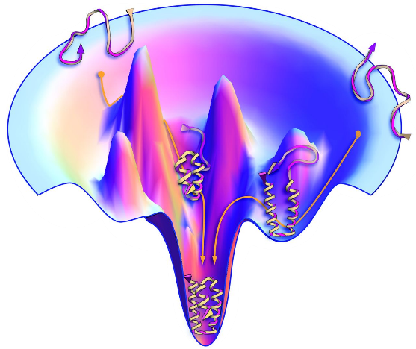
Easy Impossible Algorithm
get the primary structure
try all different conformations
take the most stable one
stability is defined by the
structure‘s energy level
the most stable structure
has the lowest energy
but: no perfect energy function is known
good estimates are
computationally expensive
Notes:
also, how can we determine the most stable structure?
stability is defined by the structure‘s energy level
the most stable structure has the lowest energy
but: no perfect energy function is known
good estimates are computationally expensive
we somehow need to express the energy efficiently

Slide 37
Algorithmic Strategies
reduction of search space
efficient
algorithm
clever energy field
representation
Ab Initio Approaches
I-TASSER
QUARK
Threading
Clustering
Monte Carlo Simulation
Refinement
Notes:
thus, there are two basic foundations for an efficient algorithm:
reduction of search space
clever representation of energy field
there are various approaches to both of these problems
we want to focus on one...

Slide 38
Algorithmic Strategies
Amino Acid Sequence
Possible Tertiary Structures
1
Threading & Preparation
2
Monte Carlo Simulation
3
Clustering & Refinement
Notes:
we are focussing on two Ab Initio algorithms, QUARK and I-TASSER
though quite different, they follow the same basic steps
first, the amino acid sequence is threaded and analysed
then, a Monte Carlo simulation is used to efficiently search through the conformational space with the help of the energy function
then, using clustering a final result is selected
we will explain each of these steps

Slide 39
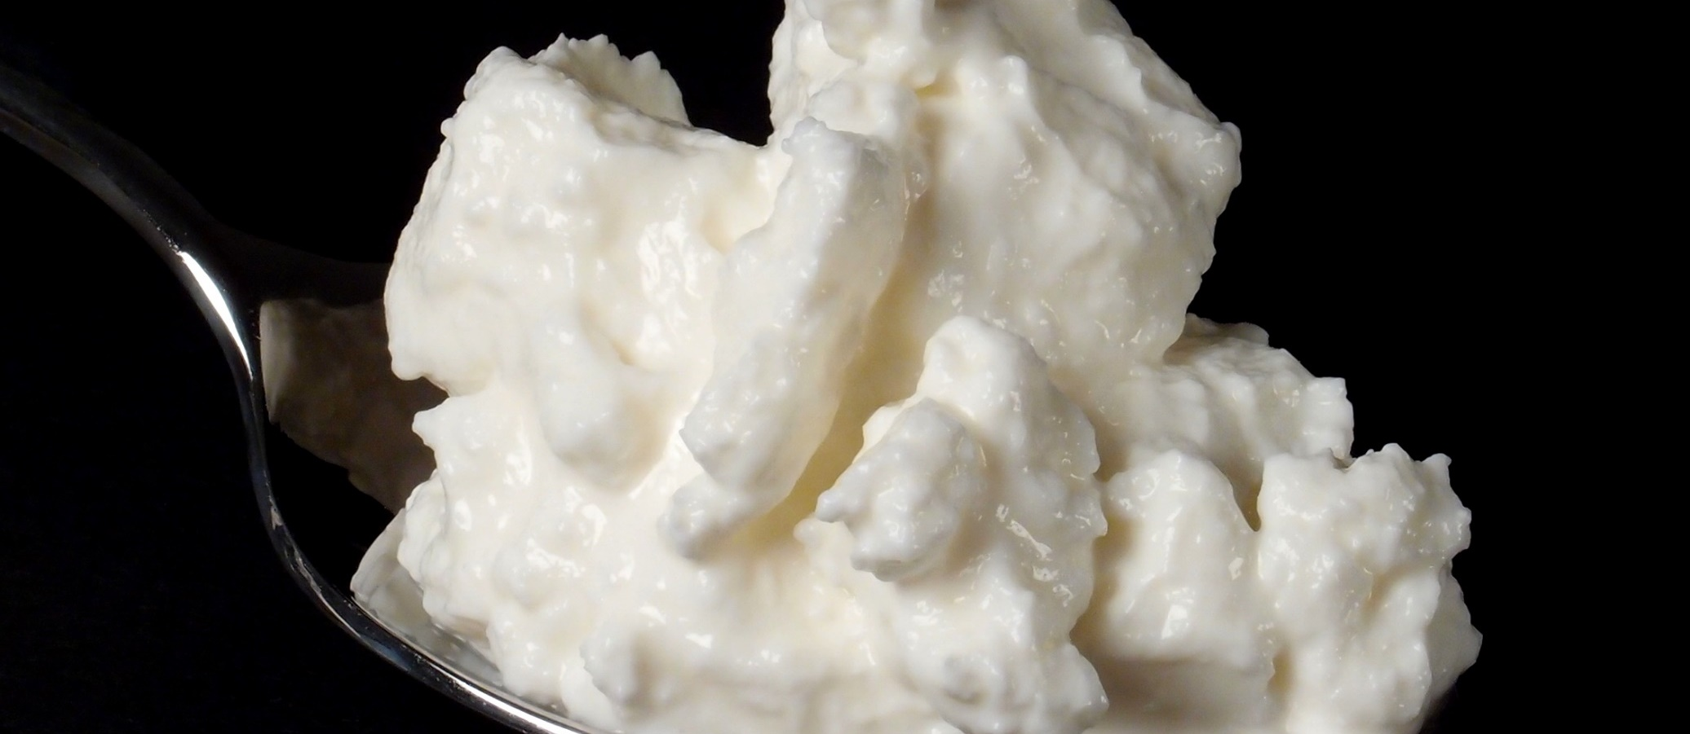
QUARK
Introduction to Proteins
Physical Structure Determination
Ab Initio Approaches
    QUARK
    I-TASSER
Prediction Quality
Outlook
Notes:
let’s start with QUARK!
it’s one of the current state-of-the-art ab initio algorithms, published in 2012
so quite new!

Slide 40
QUARK Algorithm
Overview
Amino Acid Sequence
Possible Tertiary Structures
QUARK
1
Threading & Preparation
2
Monte Carlo Simulation
3
Clustering & Refinement
Notes:
as already said, it follows this basic pattern
let‘s first have a look at step 1, the threading & preparation

Slide 41
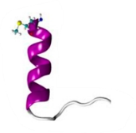
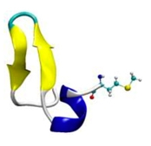
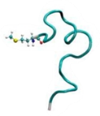
Threading & Preparation
Fragment Generation
. . .
. . .
. . .
INQPQLTKFCNNHVSTAKYNVITFLPRFLYSQFRRAANSFFLFIALLQQIPD
. . .
. . .
QUARK
Notes:
first, the amino acid sequence is divided into fragments of up to 20 residues length
the structures of these fragments is predicted using threading (comparing to known structures)
just imagine we can predict a very good structure for small fragments
these fragment structures are later used in the algorithm

Slide 42
Threading & Preparation
Secondary Structure Prediction
Helix
Strand
Helix
INQPQLTKFCNNHVSTAKYNVITFLPRFLYSQFRRAANSFFLFIALLQQIPD
QUARK
Notes:
then, the secondary structure is predicted
we can more or less safely say which parts are alpha helices or beta strands
this information will later be used in the force field, e.g. to align the strands

Slide 43
QUARK Algorithm
Overview
Amino Acid Sequence
Possible Tertiary Structures
QUARK
1
Threading & Preparation
2
Monte Carlo Simulation
3
Clustering & Refinement
Notes:
then, we are already in the second step
this is the most interesting one
we use a Monte Carlo simulation to build different structures
what does that mean?

Slide 44
Monte Carlo Simulation
Monte Carlo Algorithms
Idea | non-deterministic
 | randomized
Procedure | 1. start with random structure
 | 2. apply random changes
 | 3. adopt changes if they are better
 | 4. repeat
Result | valid
 | not necessarily optimal
structural movements
energy function
QUARK
Notes:
I guess you have all heard of that before, but I will repeat it again
basic idea: use non-deterministic approach and randomize the whole algorithm
to do this, start with a random structure (in our case, just build one from the fragments)
then, randomly apply changes and accept them if they make the protein more stable
for this, we need the energy function!
repeat this process until you decide the result is okay
the result is then a valid protein structure which is not necessarily optimal though
for this we need the energy function and the structural movements

Slide 45

Monte Carlo Simulation
Force Field Landscape
goal:
design a force field that is as
similar to the „real“ force as possible
QUARK
Notes:
again, remember that we have a complex energy field that defines the stability of a structure
our goal is to define a function that comes as close as possible to this
and for QUARK this looks like...

Slide 46
Monte Carlo Simulation
QUARK Force Field
$$\begin{matrix}E_{total}= & {w_{0}E}_{prm}+w_{1}E_{prs}+w_{2}E_{ev}+w_{3}E_{hb}+w_{4}E_{sa}+w_{5}E_{dh} \\ & +w_{6}E_{dp}+w_{7}E_{rg}+w_{8}E_{bab}+w_{9}E_{hp}+w_{10}E_{bp}\end{matrix}$$
... and what does that mean?
QUARK
Notes:
... this!
...
what does that mean?
first of all, there are obviously 11 parts to the formula
the w variables are just weighting factors and will be ignored

Slide 47
Monte Carlo Simulation
QUARK Force Field
$$E_{prm}$$ | atomic level
$$E_{prs}$$
$$E_{ev}$$
$$E_{hb}$$ | residue level
$$E_{sa}$$
$$E_{dh}$$
$$E_{dp}$$
$$E_{rg}$$ | topology level
$$E_{bab}$$
$$E_{hp}$$
$$E_{bp}$$
QUARK
Notes:
each of the 11 terms represents one specific phenomenom
they can be roughly grouped into three groups:
atomic level parts describe interactions on an atomic level
residue level parts describe interactions between whole residues
and topology level parts describe interactions between bigger fragments like secondary structures (strands, helices, ...)
let‘s take a look at a few of them, all would be too complicated

Slide 48
Monte Carlo Simulation
QUARK Force Field
backbone atomic pair-wise potential →
$$E_{prm}$$ | atomic level
$$E_{prs}$$
$$E_{ev}$$
$$E_{hb}$$ | residue level
$$E_{sa}$$
$$E_{dh}$$
$$E_{dp}$$
$$E_{rg}$$ | topology level
$$E_{bab}$$
$$E_{hp}$$
$$E_{bp}$$
$$E_{prm}\left(i,j,r_{ij}\right)=−RT\log\left(\frac{N_{obs}\left(i,j,r_{ij}\right)}{r_{ij}^{α}N_{obs}\left(i,j,r_{cut}\right)}\right)$$
H
R
O
C
C
N
C
H
H
R
QUARK
Notes:
the backbone pair-wise potential describes interactions along the backbone of the protein
these are main atoms along the chain
the formula expresses that there are certain favorable distances between them
the more these distances are fulfilled, the lower the energy
also, take a look at the exact definition
this is one of the easier terms!
to not totally loose you I will only explain the other ones

Slide 49
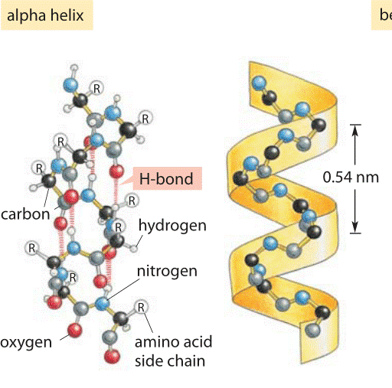
Monte Carlo Simulation
QUARK Force Field
$$E_{prm}$$ | atomic level
$$E_{prs}$$
$$E_{ev}$$
$$E_{hb}$$ | residue level
$$E_{sa}$$
$$E_{dh}$$
$$E_{dp}$$
$$E_{rg}$$ | topology level
$$E_{bab}$$
$$E_{hp}$$
$$E_{bp}$$
hydrogen bonding →
QUARK
Notes:
a residue level term is the hydrogend bonding
it describes the preference of hydrogend bonds between residues
for example, in a beta helix there are a lot of hydrogend bonds holding it together
these of course stabilize the protein!
Pic: http://book.bionumbers.org/what-is-the-energy-of-a-hydrogen-bond/

Slide 50
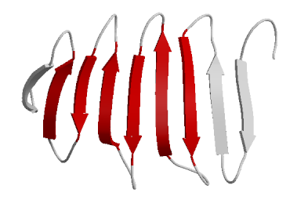
Monte Carlo Simulation
QUARK Force Field
$$E_{prm}$$ | atomic level
$$E_{prs}$$
$$E_{ev}$$
$$E_{hb}$$ | residue level
$$E_{sa}$$
$$E_{dh}$$
$$E_{dp}$$
$$E_{rg}$$ | topology level
$$E_{bab}$$
$$E_{hp}$$
$$E_{bp}$$
QUARK
strand packing →
Notes:
a topology level term is the strand packing term
it is used to e.g. align beta strands
now we can compute the energy of a protein structure...
... but how do we even represent that?

Slide 51
Monte Carlo Simulation
Structural Movements
residue | fragment | topology
QUARK
Notes:
change the protein structure randomly
hopefully improve the energy level
again, three groups:
residue level operates on one single residue
segment level operates on the fragments generated earlier
topology level tries to form well-packed pairs of secondary structures

Slide 52
Monte Carlo Simulation
Structural Movements
residue | fragment | topology
bond length
bond angle
bond torsion angle
QUARK

Slide 53
Monte Carlo Simulation
Structural Movements
residue | fragment | topology
fragment substitution
randomize backbone (as far as physically possible)
rotate backbone along fragment axis
position shift forward
QUARK

Slide 54
Monte Carlo Simulation
Structural Movements
residue | fragment | topology
α-helix packing
β-strand packing
try to form β-turns
QUARK

Slide 55
Monte Carlo Simulation
Monte Carlo Algorithms
Idea | non-deterministic
 | randomized
Procedure | 1. start with random structure
 | 2. apply random changes
 | 3. adopt changes if they are better
 | 4. repeat
Result | valid
 | not necessarily optimal
structural movements
energy function
QUARK
Notes:
are we done now that we have the missing pieces? of course not...

Slide 56
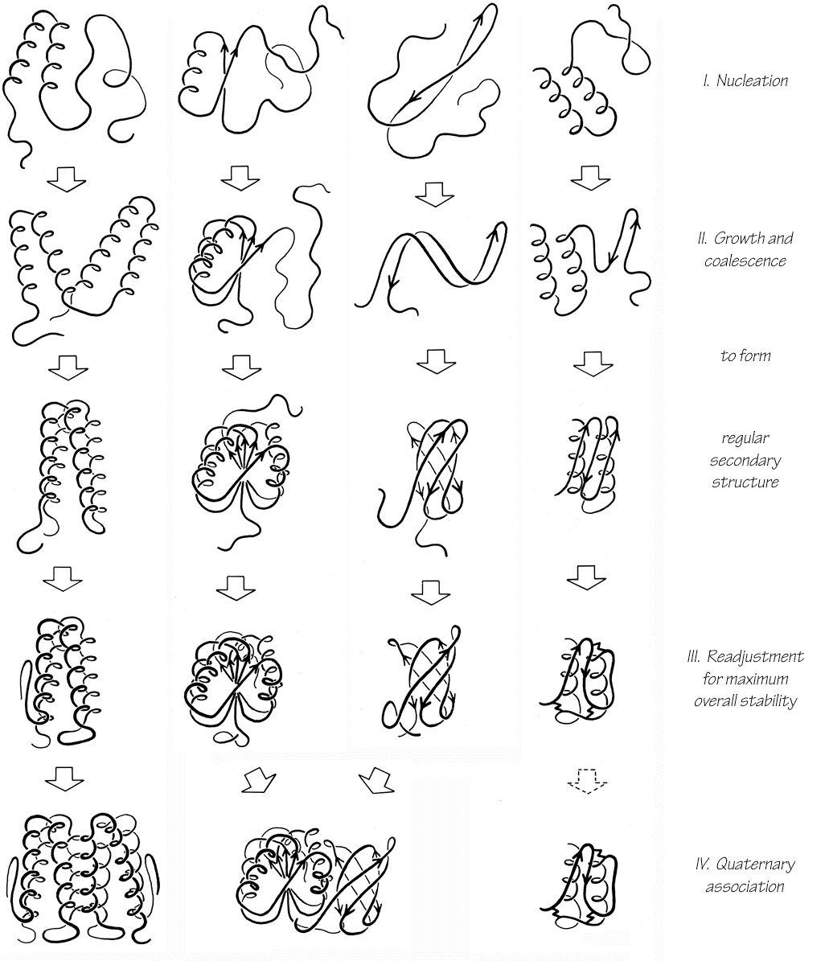
Monte Carlo Simulation
„Hill Climbing“
energy
initial structure
accept random changes if they lower the energy
reject random changes if they raise the energy
intermediate structure
native structure
QUARK
Notes:
what we are doing in the algorithm is called Hill Climbing
we start with an initial structure and change it in order to climb the hill
in our case, we of course search for the minimum
we accept random changes if they lower the energy
and reject them if the raise it
hopefully: arrive at the native structure sometime
of course it is not that easy...

Slide 57
Monte Carlo Simulation
Problem: Local Minima
energy
initial structure
correct global minimum,
native structure
incorrect local minimum
QUARK
Notes:
we get stuck in local mimima!
from our initial position, there might not be a downhill way to the native structure
instead, we get to a local minimum and assume it is the final solution
how can we get out of this?

Slide 58

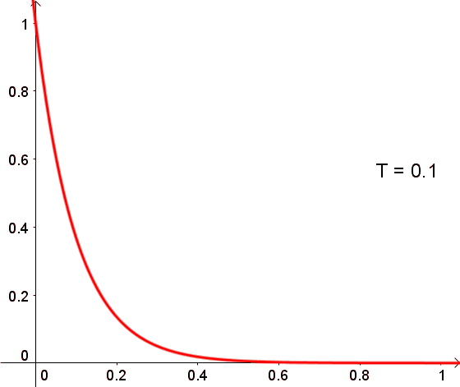
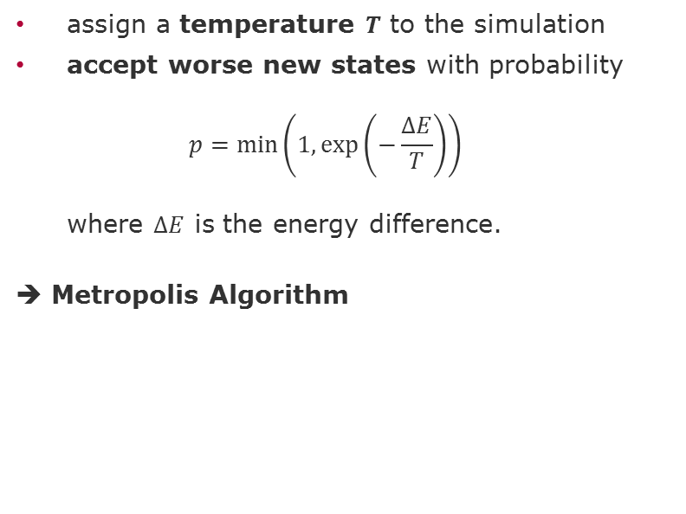
Monte Carlo Simulation
Breaking out of Local Minima
assign a temperature $T$ to the simulation
accept worse new states with probability
$p=\min\left(1,\exp\left(−\frac{ΔE}{T}\right)\right)$
where $ΔE$ is the energy difference.
➔ Metropolis Algorithm
$$p$$
$$ΔE$$
QUARK
Notes:
solution: also accept worse states sometimes!
for this, assign a temperature to the simulation
the temperature determines how far we are allowed to go uphill again
this is basically how many processes work in reality, e.g. if you melt and cool metal
this way we can break out of local minima
but for QUARK this is still not clever enough...

Slide 59
Monte Carlo Simulation
Replica Exchange
exchange neighbouring replicas
according to Metropolis criterion
Temperature
...
QUARK
Notes:
we also do replica exchange
we do 40 parallel simulations with their own structure
each simulation has their own temperature, from very low to very high
in the low ones, there is not much going on
in the high ones, lots of new structures are found (many garbage, but good ones also)
at certain times, use these differences and swap the structure of neighbouring replicas
thus, good new ideas from the high temperature replicas can be used in the low temperature ones
in the end, we have a lot of good structures!
one piece is still missing, though: what do we even change?

Slide 60

Monte Carlo Simulation
REMC Termination
complex termination criteria...
but generally:
  at most 200 cycles à 30 structural movements
  after each cycle replica exchange
QUARK
Notes:
so, when do we terminate the algorithm?
there are complex criteria defined in the QUARK paper
but basically: do at most 200 cycles
30 movements per cycle
after each cycle a replica exchange
then we terminate and are satisfied!

Slide 61
QUARK Algorithm
Overview
Amino Acid Sequence
Possible Tertiary Structures
QUARK
1
Threading & Preparation
2
Monte Carlo Simulation
3
Clustering & Refinement
Notes:
but wait, we have third step
we do not just use the „best“ model returned by the algorithm
instead, we do clustering

Slide 62
Clustering & Refinement
Clustering
QUARK force field
„real“ energy
QUARK
Notes:
QUARK force field is not equal to „real“ energy function
remember, it is just an approximation
best solution according to force field need not be best solution according to QUARK force field
thus, don‘t just take the solution with the lowest QUARK energy
instead, take all the best solutions and choose the „median“

Slide 63
Clustering & Refinement
Clustering
QUARK force field
best solution
SPICKER
„real“ energy
selection of best solutions from QUARK force field
QUARK
best solution
QUARK force field
Notes:
here is an example with a few sample solutions
the best solution according to our force field is clear
but there are actually better solutions
because of the properties of our energy field, we suppose that there are clusters near the „real best solution“
use this knowledge an choose the median!

Slide 64
Clustering & Refinement
Clustering
best solution
SPICKER
„real“ energy
QUARK
best solution
QUARK force field
Notes:
this way, we might arrive at a far better solution
this is of course not always the case
there might still be better solutions
this much to QUARK, let‘s continue with I-TASSER

Slide 65

I-TASSER
Introduction to Proteins
Physical Structure Determination
Ab Initio Approaches
    QUARK
    I-TASSER
Prediction Quality
Outlook
Notes:
Let me point out the differences to a slightly different approach.
Image from https://apfeleimer.de/wp-content/uploads/2014/02/6.jpg

Slide 66
Overview
I-TASSER
Amino Acid Sequence
Possible Tertiary Structures
I-TASSER
1
Threading & Preparation
2
Monte Carlo Simulation
3
Clustering & Refinement
Notes:
I-TASSER: iterative threading assembly refinement
as already said, it follows this basic pattern
let‘s have a look at step 1, the threading & preparation

Slide 67

Threading & Preparation
Template Threading with LOMETS
Threading
Comparing and applying already known structures from a knowledge base to the searched structure.
LOMETS
LOcal MEta Threading Server
…
…
PPAS
Env-PPAS
wPPAS
MUSTER
I-TASSER
Notes:
Knowledge base = Protein Data Bank (PDB)
8 different threading programs with slightly different approaches
Search for templates, similar as we heard in the DNA template search
Results are scored, the more similar alignments are to each other, the higher the score
20 best of each program are send to LOMETS

Slide 68
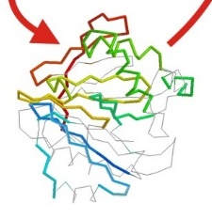
Threading & Preparation
Template Threading with LOMETS
…
evaluation within one program
LOMETS
ranking between programs
init.dat
cutoff:6.0
* 0.437
PPAS
restraints for
energy function
cutoff:6.1
* 0.460
MUSTER
I-TASSER
…
Notes:
For each template and alignment, LOMETS creates a score
Based on score from program
Global cutoff from benchmark for each program → recognize good and bad
Global comparison by additional factor also determined by benchmarks
I-TASSER generates spatial restraints for structure and template with initial conformations
Aligned and unaligned parts (not changed too much in camparison to QUARK)

Slide 69
Overview
I-TASSER
Amino Acid Sequence
Possible Tertiary Structures
I-TASSER
1
Threading & Preparation
2
Monte Carlo Simulation
3
Clustering & Refinement
Notes:
The next steps are very similar to QUARK
I‘ll use another flowchart to explain them shortly

Slide 70
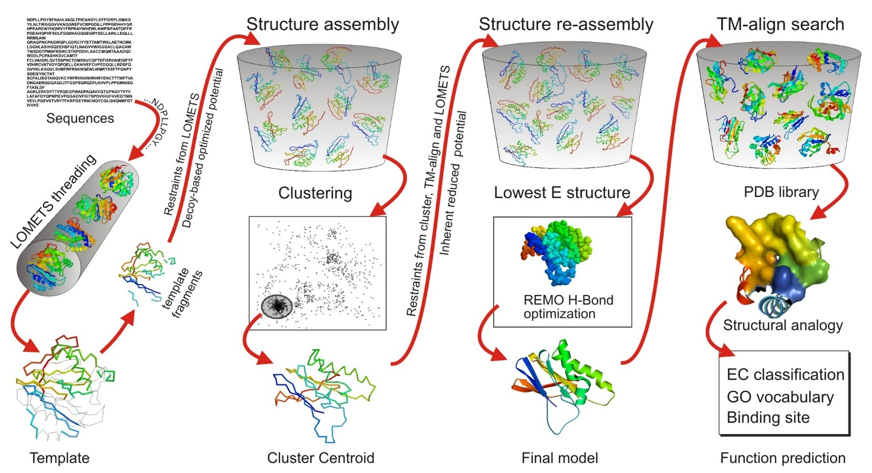
Overview
I-TASSER
1
Threading & Preparation
2
Monte Carlo Simulation
4
Function Prediction
3
Clustering & Refinement
I-TASSER
Notes:
In Monte Carlo simulations, aligned and unaligned regions are simulated differently
Aligned max. accuracy (off-lattice)
Unaligned max. efficiency (on-lattice)
Iterative in refinement: another Monte Carlo Simulation
What is interesting: function prediction as fouth step

Slide 71
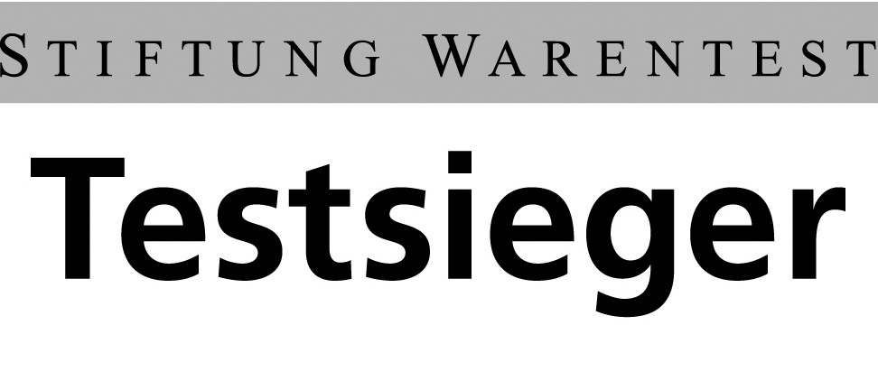
Prediction Quality
Introduction to Proteins
Physical Structure Determination
Ab Initio Approaches
    QUARK
    I-TASSER
Prediction Quality
Outlook
Notes:
[some transition from the former to this part]
Image modified from http://www.pressebox.de/uploads/thumbnail/width/400/height/320/id/35200.jpg

Slide 72
Scoring and Quality Criteria
RMSD
… measures (local) structural similarity between two structures
… average deviation of backbone atoms
… 0 → identical, the lower the better
… difficult to interpret
TM-score
… measures (global) structural similarity between two structures
… grants greater weight to small deviations
… 1 → identical, the higher the better
… > 0.5 → model of correct topology
Prediction Quality
Notes:
Two most common
Compare experimentally found structure to predicted
RMSD: root-mean-square deviation
TM-score: template modeling score

Slide 73
I-TASSER
1ogwA_ | TM-score | RMSD
I-TASSER | 0.88 | 1.1
native structure
Prediction Quality
I-TASSER
Notes:
Images from I-TASSER paper Ab initio modeling of small proteins by iterative TASSER simulations
TM-scores from http://bmcbiol.biomedcentral.com/articles/10.1186/1741-7007-5-17

Slide 74
I-TASSER
1dcjA_ | TM-score | RMSD
I-TASSER | 0.39 | 10.0
native structure
Prediction Quality
I-TASSER
Notes:
Images from I-TASSER paper Ab initio modeling of small proteins by iterative TASSER simulations
TM-scores from http://bmcbiol.biomedcentral.com/articles/10.1186/1741-7007-5-17

Slide 75
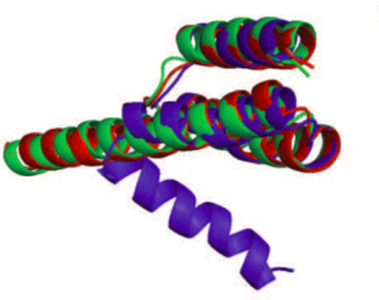
QUARK
2gybT | TM-score | RMSD
QUARK | 0.90 | 1.30
Rosetta | 0.68 | 4.81
native structure
QUARK
Prediction Quality
Rosetta
Notes:
Images from QUARK paper (Ab initio protein structure assembly using continuous structure fragments and optimized knowledge-based force field)

Slide 76
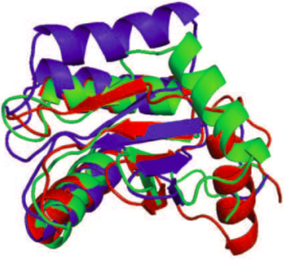
QUARK
1jo0A | TM-score | RMSD
QUARK | 0.61 | 6.05
Rosetta | 0.57 | 6.15
native structure
QUARK
Prediction Quality
Rosetta
Notes:
Images from QUARK paper (Ab initio protein structure assembly using continuous structure fragments and optimized knowledge-based force field)

Slide 77
Critical Assessment of Protein Structure Prediction
“The main goal of CASP is to obtain an in-depth and objective assessment of our current abilities and inabilities in the area of protein structure prediction. To this end, participants will predict as much as possible about a set of soon to be known structures. These will be true predictions, not ‘post-dictions’ made on already known structures.”
“The main goal of CASP is to obtain an in-depth and objective assessment of our current abilities and inabilities in the area of protein structure prediction. To this end, participants will predict as much as possible about a set of soon to be known structures. These will be true predictions, not ‘post-dictions’ made on already known structures.”
http://www.predictioncenter.org/casp10/#goals
Prediction Quality
Notes:
Measures how good different prediction methods are compared to each other
Double-blind: Neither predictors nor organizers know the actual structures of target proteins in beforehand
Every two years, starting with CASP1 in 1994

Slide 78
CASP10 Results
Rank | Predictor | TM-score | RMSD
1 | I-TASSER | 0.89 | 6.3
2 | QUARK | 0.87 | 6.5
3 | Rosetta | 0.84 | 7.5
4 | chunk-TASSER | 0.82 | 8.2
5 | MULTICOM | 0.81 | 10.1
… | … | … | …
Prediction Quality
Notes:
Rosetta: only templates
Chunk-TASSER: no iteration, uses templates from SP3, not LOMETS
MULTICOM: template based, too

Slide 79
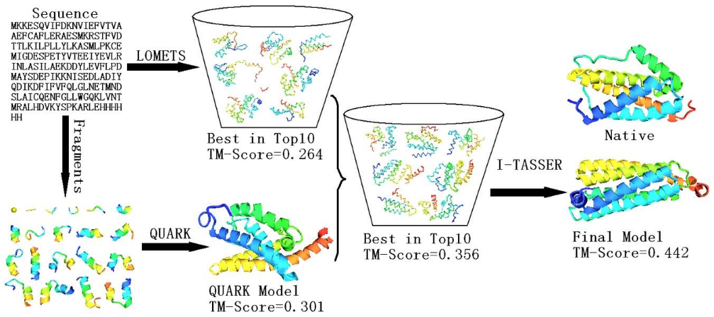
QUARK & I-TASSER
Prediction Quality
Notes:
Hard target
TM-score only I-TASSER 0.42
Image from http://www.ncbi.nlm.nih.gov/core/lw/2.0/html/tileshop_pmc/tileshop_pmc_inline.html?title=Click%20on%20image%20to%20zoom&p=PMC3&id=3228277_nihms314031f7.jpg

Slide 80
General Assessment
hours to days for QUARK/I-TASSER vs. weeks for experimental methods
much less expensive
insufficient quality of predicted models (especially for long proteins)
but…
confidence scores
experts can use valuable clues from the models about structures
experts can enhance the models
use models together with experimental methods
Prediction Quality
Notes:
Long proteins for QUARK: >100-120
Confidence score
One program e.g. I-TASSER: how good were the templates from LOMETS, how likely is it to get a good structure from that
Multiple programs: how many predict the same thing
Clues: espiecially when no experimental structure is available
Together with experimental methods (in either way, error recognition or too few information)

Slide 81

Outlook
Introduction to Proteins
Physical Structure Determination
Ab Initio Approaches
    QUARK
    I-TASSER
Prediction Quality
Outlook
Notes:
http://www.globalgate.de/wp-content/uploads/2015/10/Fotolia_86858767_Subscription_Monthly_XL.jpg

Slide 82
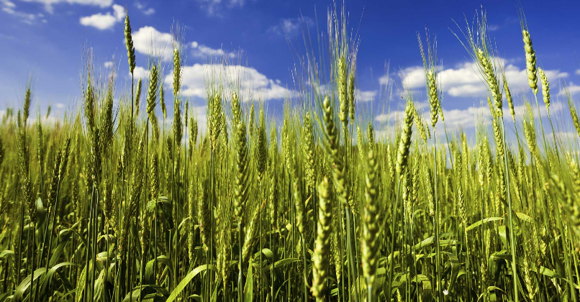
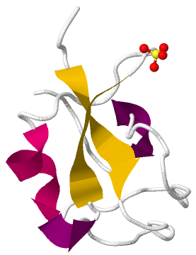
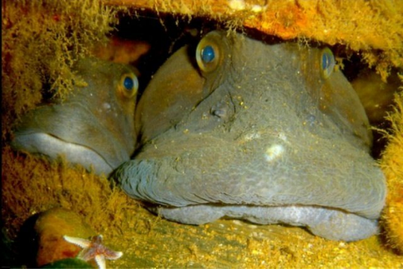
Protein Design
Antifreeze Proteins
Notes:
ocean pout from the Northwest Atlantic Ocean
very vold there, but does not freeze
why is that? because of an antifreeze protein
this was improved a lot by different approaches, which might also include protein structure prediction
today, this is used in genetically engineered crops
or in medicine when conserving organ transplants
with that nice image we

Slide 83
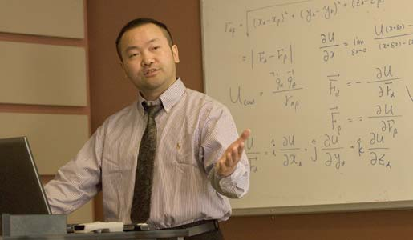
Bibliography
Lee, Jooyoung, Sitao Wu, and Yang Zhang. "Ab initio protein structure prediction." From protein structure to function with bioinformatics. Springer Netherlands, 2009. 3-25.
Swendsen, Robert H., and Jian-Sheng Wang. "Replica Monte Carlo simulation of spin-glasses." Physical Review Letters 57.21 (1986): 2607.
Xu, Dong, and Yang Zhang. "Ab initio protein structure assembly using continuous structure fragments and optimized knowledge‐based force field." Proteins: Structure, Function, and Bioinformatics 80.7 (2012): 1715-1735.
Yang, Jianyi, et al. "The I-TASSER Suite: protein structure and function prediction." Nature methods 12.1 (2015): 7-8.
Zhang, Yang. "Interplay of I‐TASSER and QUARK for template‐based and ab initio protein structure prediction in CASP10." Proteins: Structure, Function, and Bioinformatics 82.S2 (2014): 175-187.
Zhang, Yang. "Template‐based modeling and free modeling by I‐TASSER in CASP7." Proteins: Structure, Function, and Bioinformatics 69.S8 (2007): 108-117.
Notes:
Pic: http://www.oread.ku.edu/2008/march/3/zhang.shtml

Slide 84
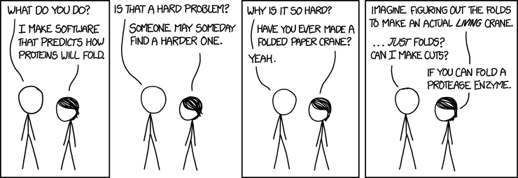
Thank you for your attention!
Notes:
Randomly found on http://xkcd.com/

