Slide 1
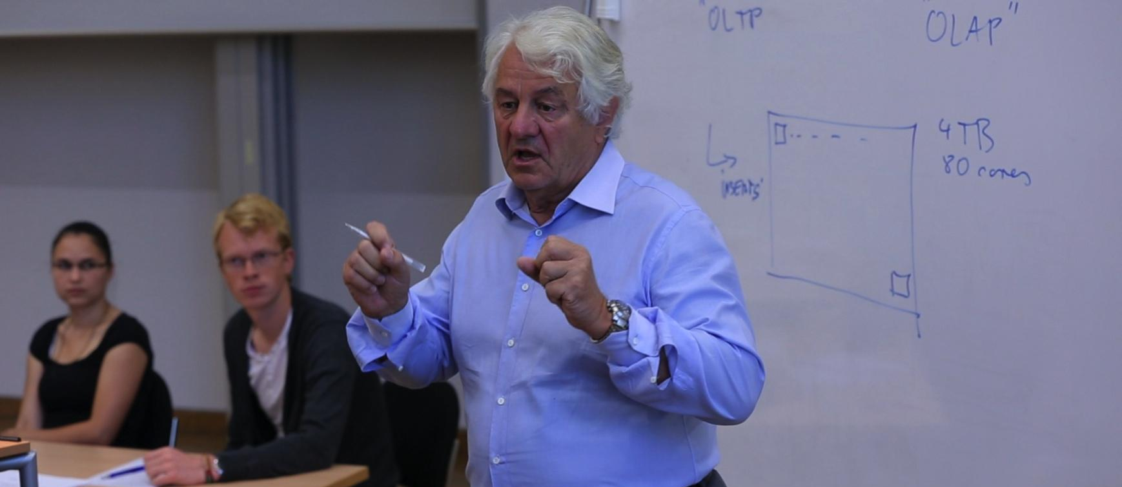
Trends and Concepts in Software Industry II

Slide 2
Learning Goals
Participants will gain
deep technical understanding of real-world challenges in enterprise computing faced by Zalando, one of Europe‘s biggest e-commerce fashion platforms which was founded 2008 in Berlin.
Learning areas include
Characteristics of enterprise applications, systems, and processes
Hands-on experience with cloud platforms (AWS), SAP tools, data analytics

Slide 3
Seminar Overview
General Information
6 ECTS (graded)
Enrollment until October 30, 2019
https://hpi.de/plattner/teaching/winter-term-201920/trends-and-concepts-in-the-software-industry-ii.html
Grading
Active participation in discussions, the project and team work, intermediate presentations, and block week (30%)
Project results and final presentation (40%)
Documentation of the results (30%)

Slide 4
Seminar Schedule
Enrollment Deadline
Group Assignment
Kick-off at Zalando
Deadline Documentation Submission
Intermediate Presentations
Group Work & Prep
Block Week
tba
10th of February
14th of February
30th of October
Mid-November
January 2020

Slide 5
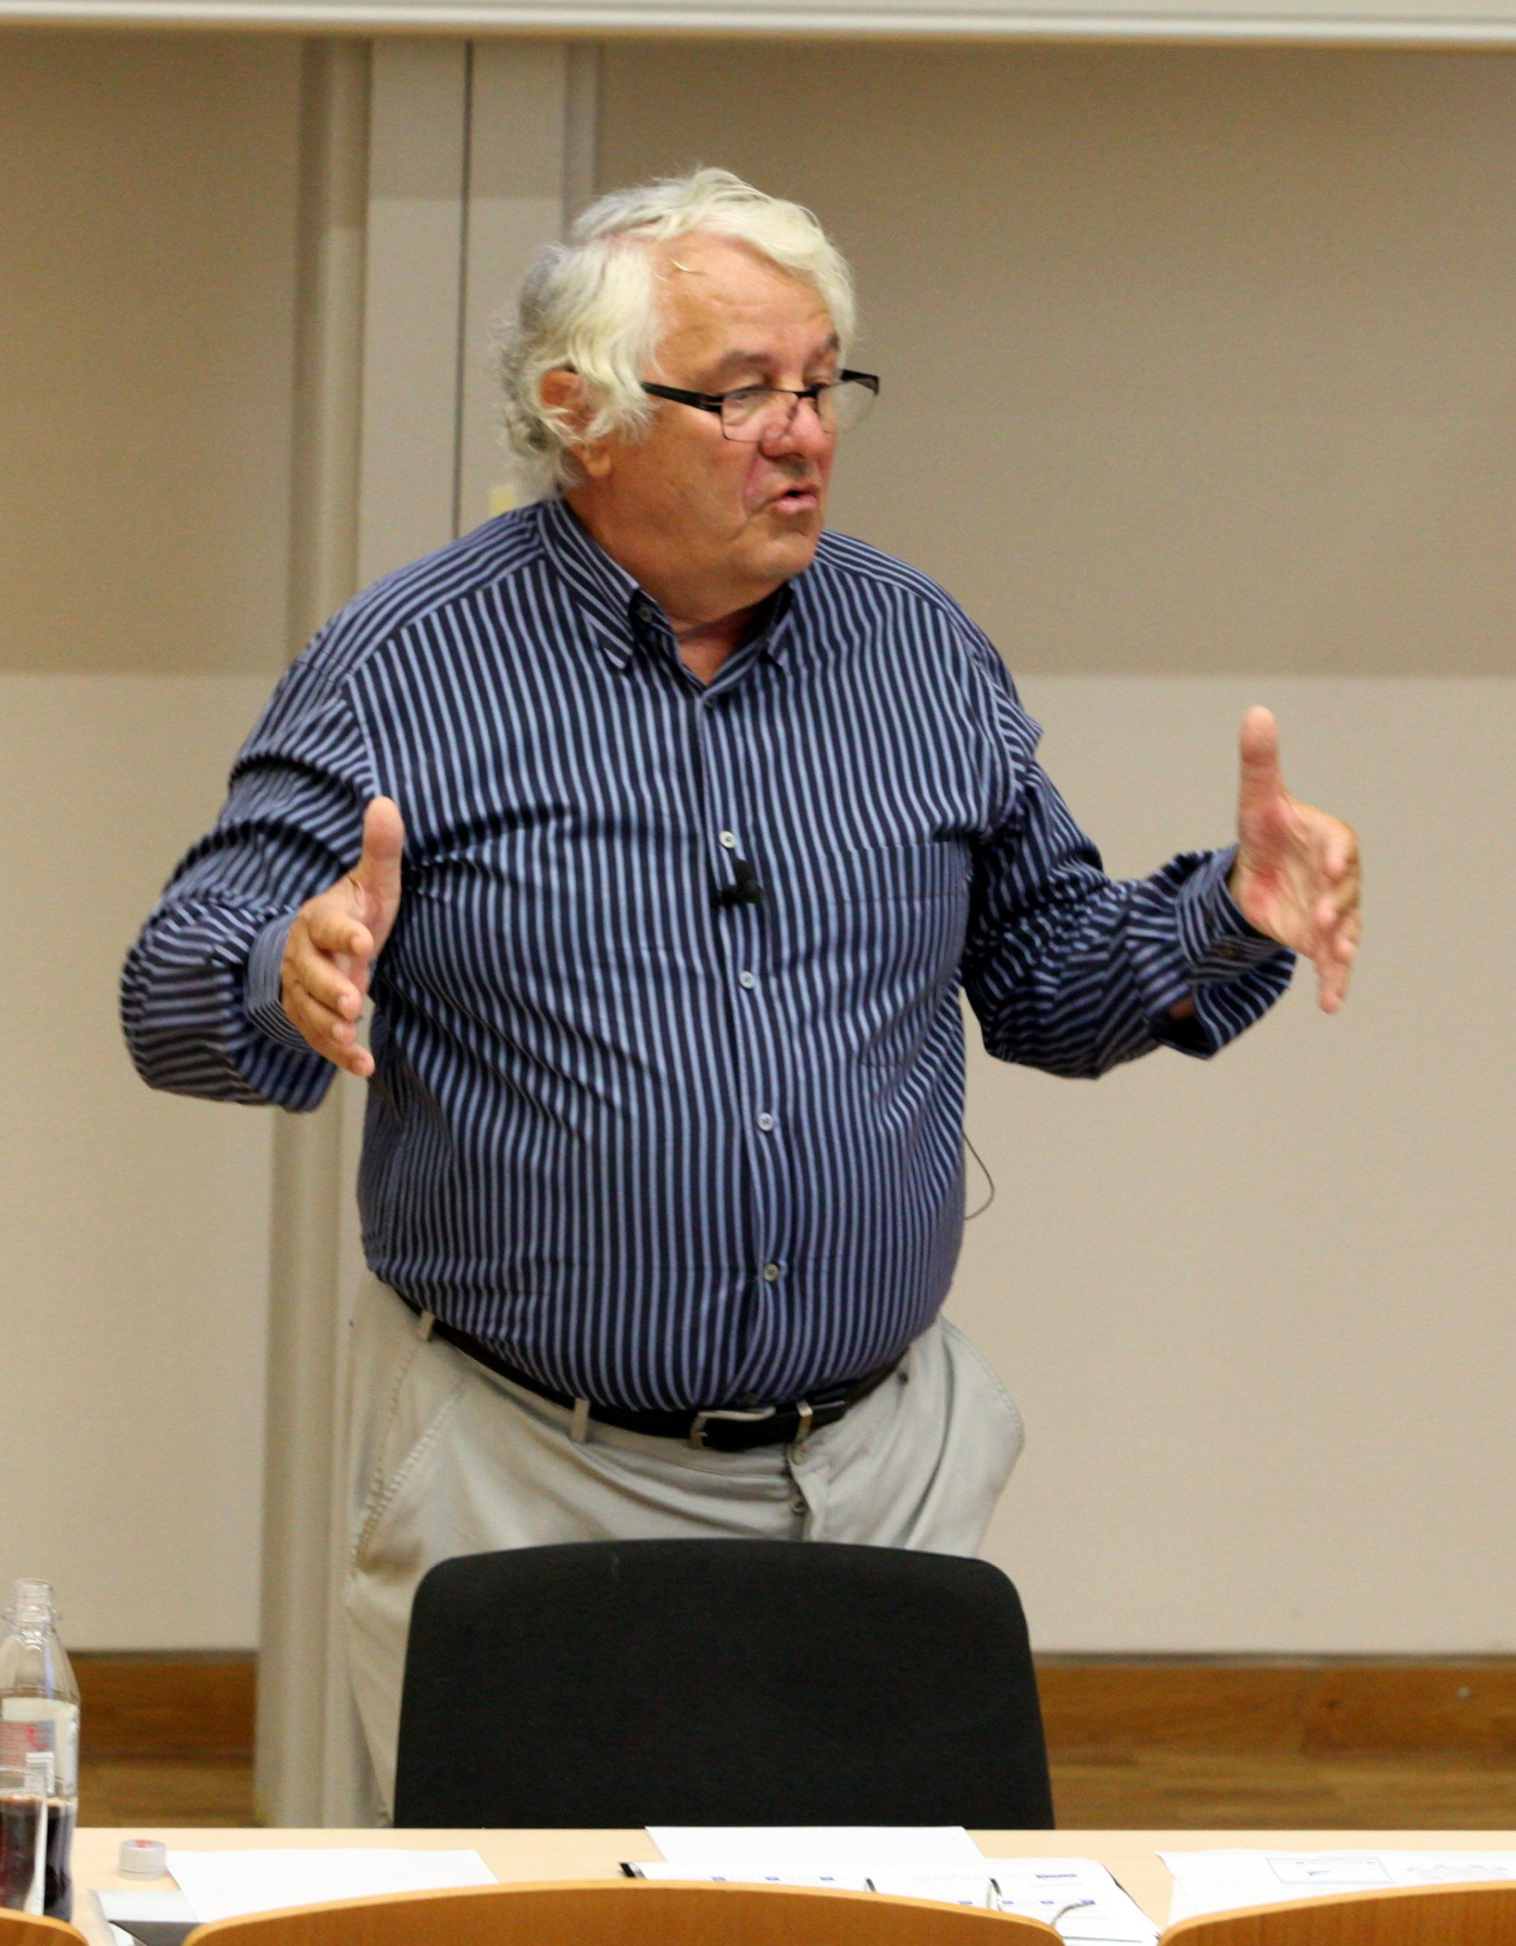
Block Week
Presentation: challenge/current situation, insights, initial prototype ideas
Ideation and Implementation of a prototype
Test/evaluation with Zalando experts
Final presentations
5 days
Notes:
Non volatile memory

Slide 6
Focus Areas
Process Mining
Data Pipelines
Schema Handling
Data Science
ML with Spark
Demo Platform for ML Use Cases
Reporting and Analytics
Planning
Data Virtualization / Consumption Layer
Data Management
Data Sharing / Integration
Event Busses

Slide 7
Contacts
Dr. Matthias Uflacker
Room: V-2.18
Email: matthias.uflacker@hpi.de
Guenter Hesse
Room: V-2.03
Email: guenter.hesse@hpi.de
Phone: 1381

